Slide 1
Images for User Guide

Slide 2
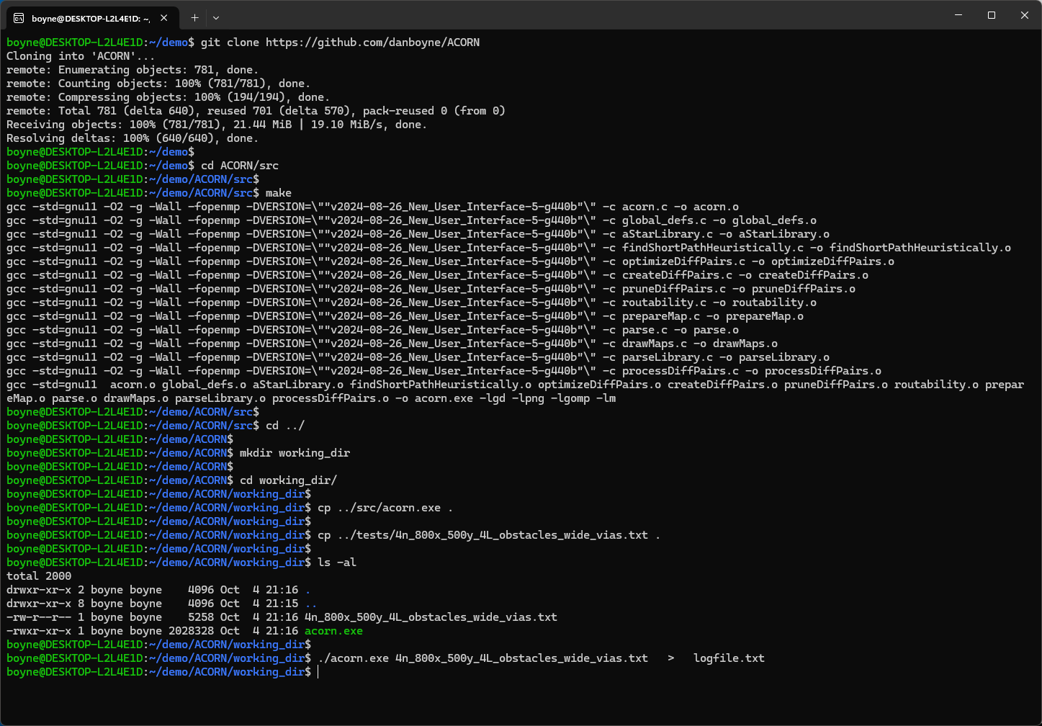
Download Acorn from GitHub
Type 'make' in 'src' directory to compile Acorn.
Create a working directory
Copy 'acorn.exe' and a test-case to the working directory
Run Acorn

Slide 3
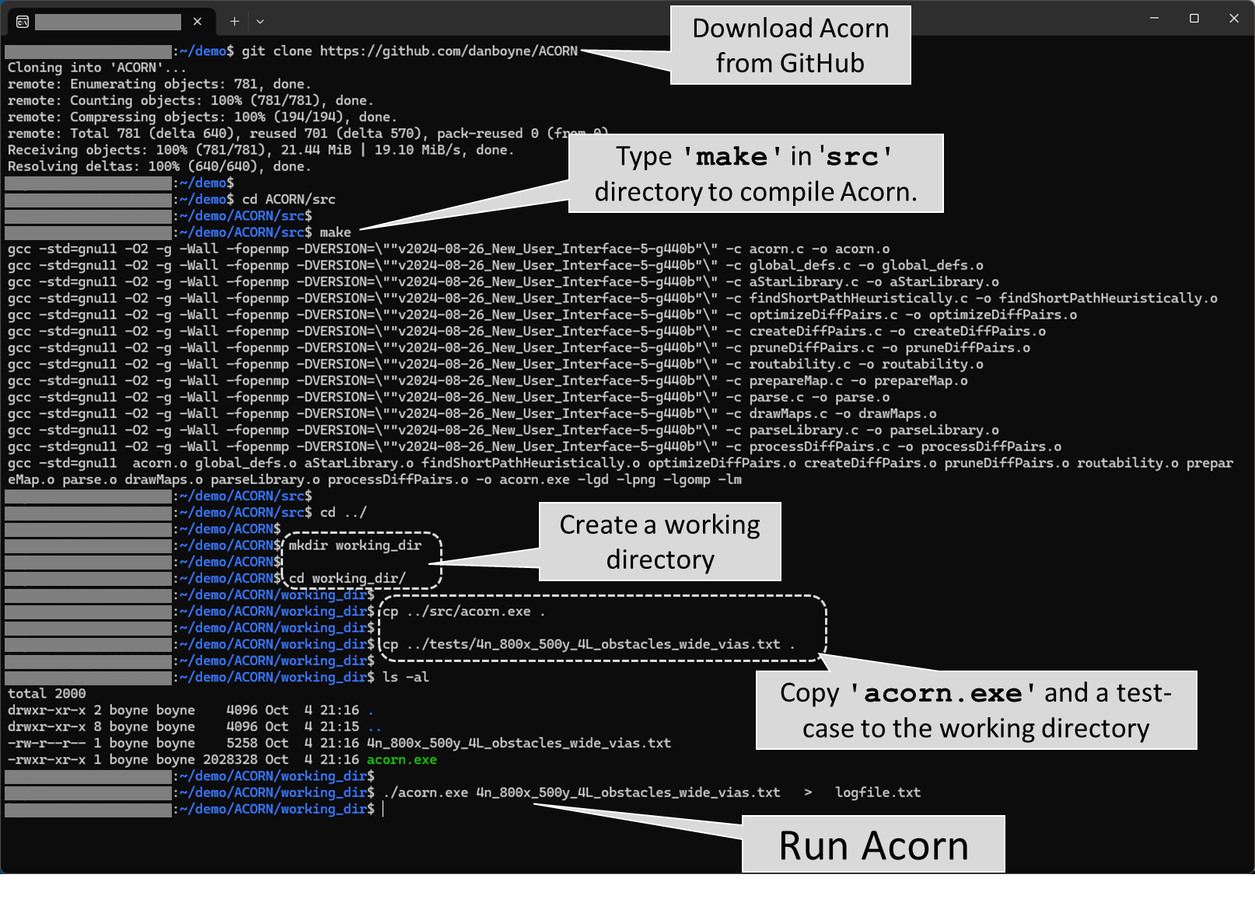

Slide 4
Images for Manuscript

Slide 5
Problem Scope

Slide 6
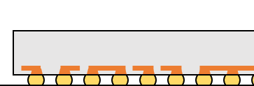
Redistribution layer(s) on die
Routing layers on
flip-chip package
PCB
routing

Slide 7
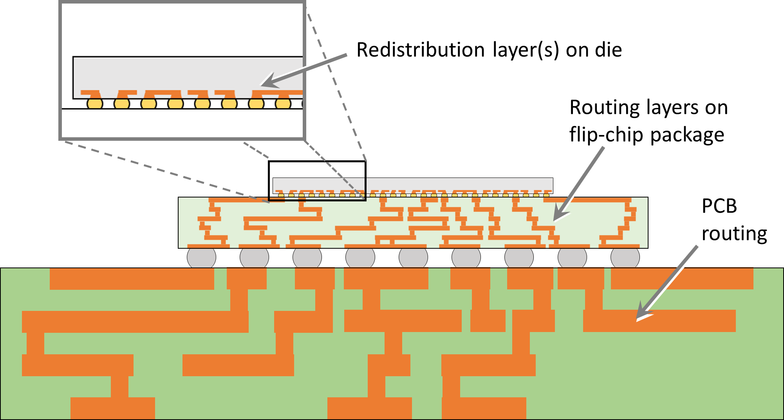

Slide 8
Routing Layers and Boundaries

Slide 9
a.
Boundaries for die-to-package vias
Boundaries for package-to-PCB vias
y
x
Boundaries for routing layer on dies
Boundaries for package routing layers
Boundaries for PCB routing layers
Die
#1
Die
#2
Die
#3
Package
#1
Package
#2
b.
Layers shown are routing layers, and should not be confused with laminate layers, each of which can contain multiple routing layers.
Die
#1
Die
#2
Die
#3
y
Package #1
Package #2
There is no restriction that each die (or package) must have the same number of routing layers as other die (packages) on the PCB.
x
PCB
z

Slide 10
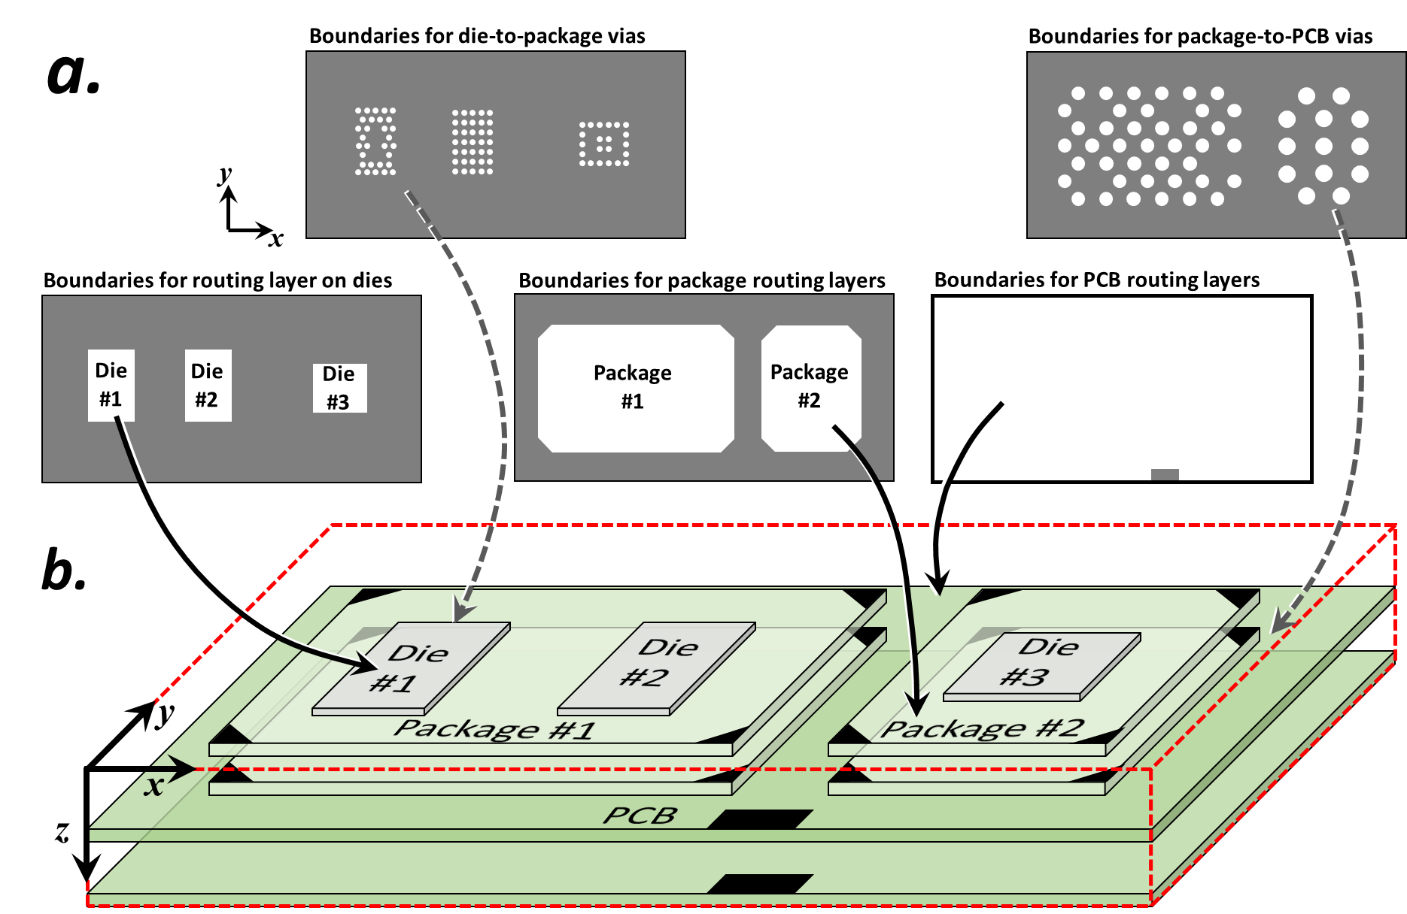

Slide 11
Boundaries for die-to-package vias
Boundaries for package-to-PCB vias
y
x
Boundaries for routing layer on dies
Boundaries for package routing layers
Boundaries for PCB routing layers
Die
#1
Die
#2
Die
#3
Package
#1
Package
#2
Die
#1
Die
#2
Die
#3
y
Package #1
Package #2
x
PCB
z

Slide 12
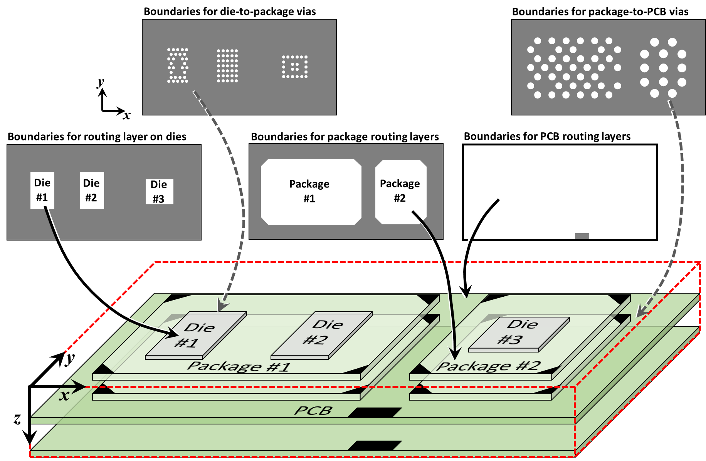

Slide 13
Routing Design Rules

Slide 14
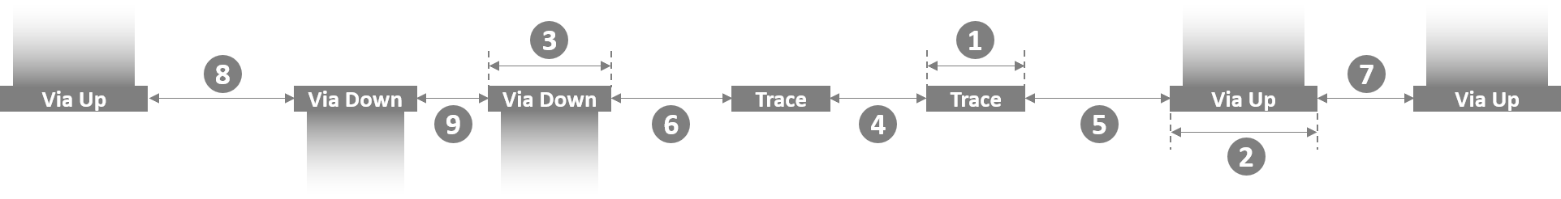

Slide 15
Pin Swapping

Slide 16
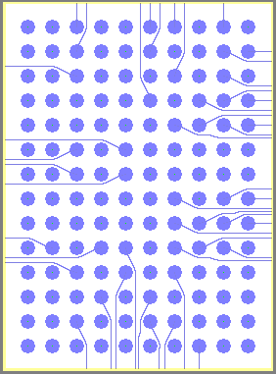
a.
b.
Two pin-swap zones
RAM
8 swap-
pable
terminals
8 swap-
pable
terminals
Non-swappable terminals
Lower-left corner of pin-swap zone
(yellow) contains terminals of all nets.

Slide 17
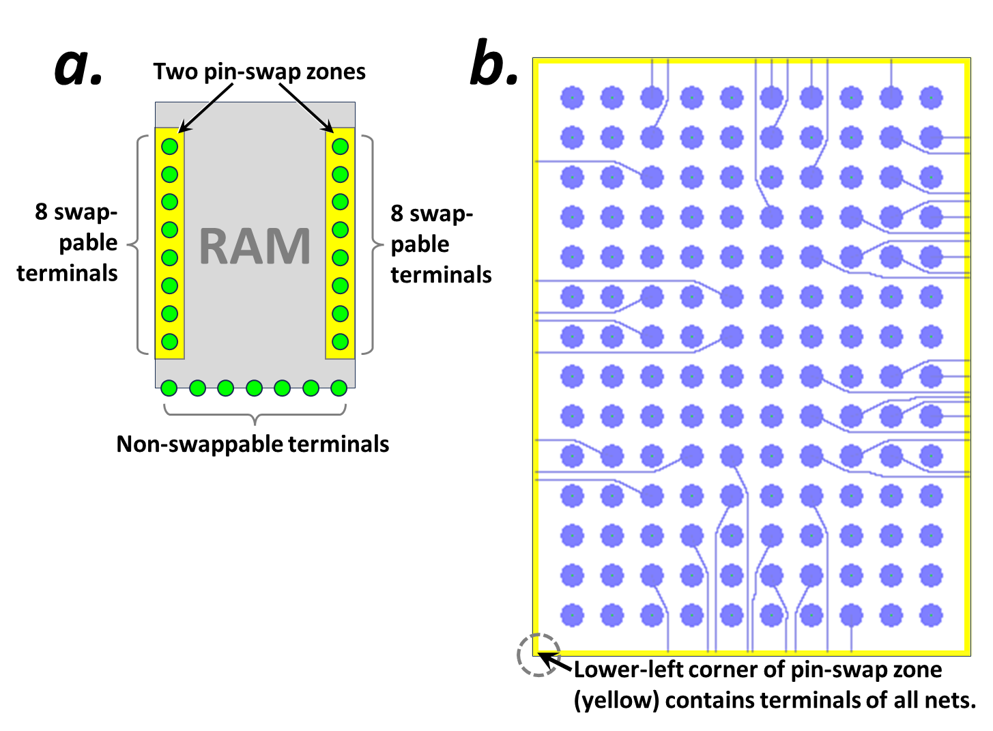

Slide 18
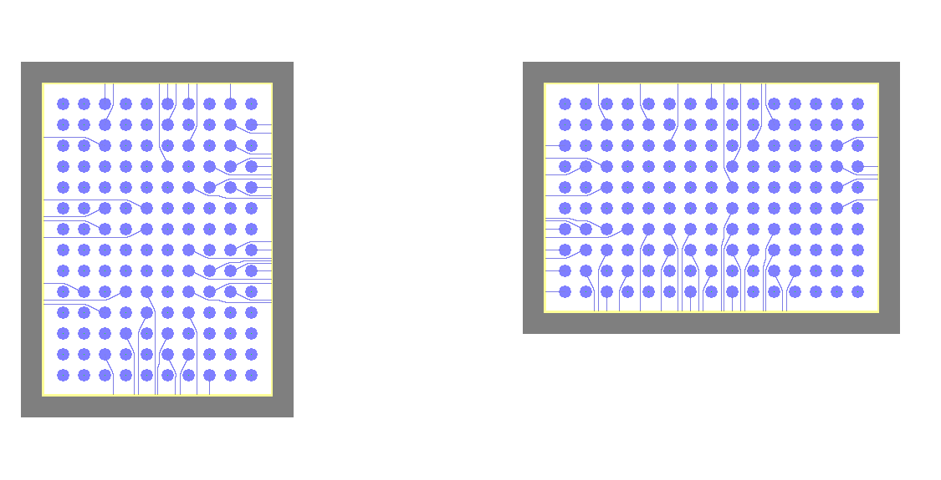
\\wsl.localhost\Ubuntu\home\boyne\autorouter\REGRESSION_TESTING--c7g.4xlarge--5Jul2024\90n_45mmX23mm_1L_twoSingleComponentEscapeRouting_40umRes\map_iter0146_02_ROUTING.png

Slide 19
Escape Routing

Slide 20
Die
Package
Single pin-swap zone along base of package
(yellow) contains terminals of all nets.

Slide 21
Single pin-swap zone along perimeter of PCB
(yellow) contains terminals of all nets.
Die
Package
PCB

Slide 22
a.
Die
Package
Single pin-swap zone along base of package (yellow) contains terminals of all nets.
b.
Single pin-swap zone along perimeter of PCB
(yellow) contains terminals of all nets.
Die
Package
PCB

Slide 23
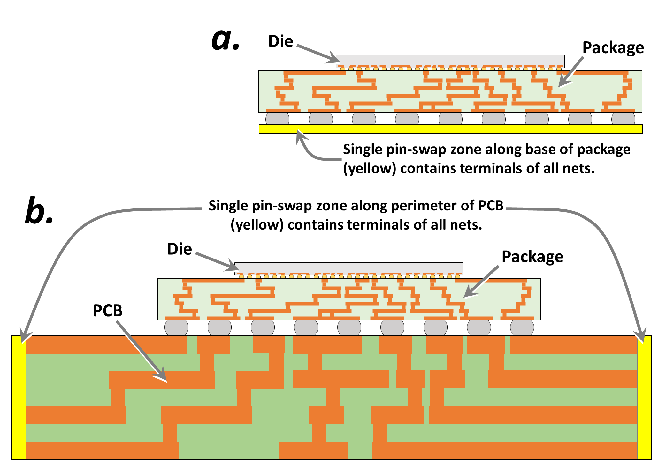

Slide 24
Algorithm

Slide 25
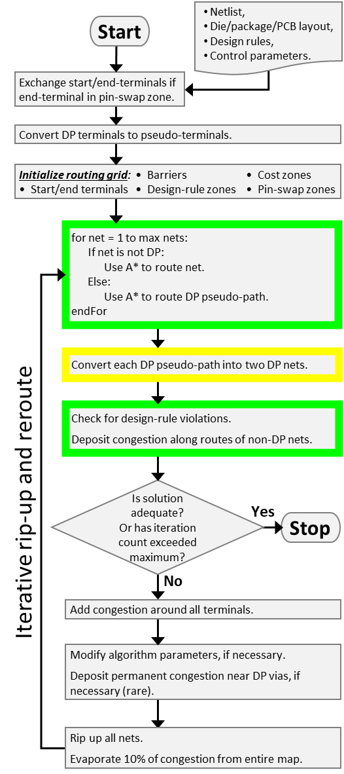
Netlist,
Die/package/PCB layout,
Design rules,
Control parameters.
Start
Exchange start/end-terminals if end-terminal in pin-swap zone.
Convert DP terminals to pseudo-terminals.
Initialize routing grid: • Barriers • Cost zones
• Start/end terminals • Design-rule zones • Pin-swap zones
for net = 1 to max nets:
If net is not DP:
Use A* to route net.
Else:
Use A* to route DP pseudo-path.
endFor
Convert each DP pseudo-path into two DP nets.
Check for design-rule violations.
Deposit congestion along routes of non-DP nets.
Is solution adequate?
Or has iteration count exceeded maximum?
Iterative rip-up and reroute
Yes
Stop
No
Add congestion around all terminals.
Modify algorithm parameters, if necessary.
Deposit permanent congestion near DP vias, if necessary (rare).
Rip up all nets.
Evaporate 10% of congestion from entire map.

Slide 26
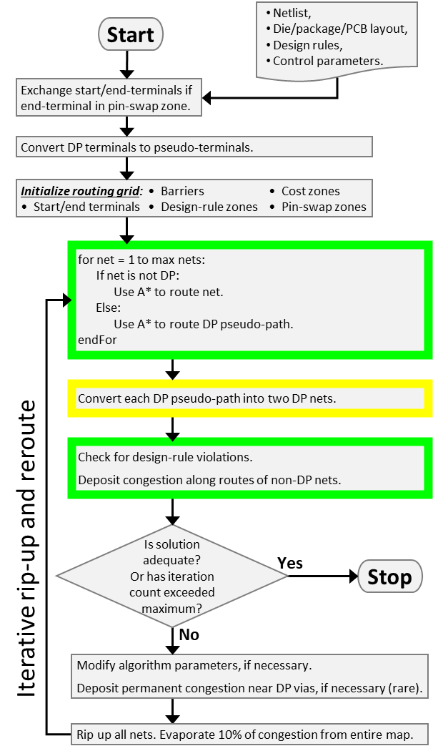
Netlist,
Die/package/PCB layout,
Design rules,
Control parameters.
Start
Exchange start/end-terminals if end-terminal in pin-swap zone.
Convert DP terminals to pseudo-terminals.
Initialize routing grid: • Barriers • Cost zones
• Start/end terminals • Design-rule zones • Pin-swap zones
for net = 1 to max nets:
If net is not DP:
Use A* to route net.
Else:
Use A* to route DP pseudo-path.
endFor
Convert each DP pseudo-path into two DP nets.
Check for design-rule violations.
Deposit congestion along routes of non-DP nets.
Is solution adequate?
Or has iteration count exceeded maximum?
Iterative rip-up and reroute
Yes
Stop
No
Modify algorithm parameters, if necessary.
Deposit permanent congestion near DP vias, if necessary (rare).
Rip up all nets. Evaporate 10% of congestion from entire map.

Slide 27
Is connection on 1 layer?
Try a simple, geometric-based heuristic to optimize wiring configuration.
Start
Yes
No
Does geometric heuristic provide conclusive answer?
Sample the previous congestion around the connection's 4 terminals.
No
Does previous congestion unambiguously reveal previous wiring configuration?
Yes
No
Run compute-intensive optimation and assign 'swap' value based thereon.
Assign 'swap' value based on geometric heuristic.
Yes
Do diff-pair paths have DRCs on previous iterations?
Yes
Assign 'swap' value based on previous congestion.
End
No

Slide 28
Start
Compare FC_{NS} & FC_{S}
NS > S
NS < S
NS ≈ S
Compare DRC_{NS} & DRC_{S}
NS > S
NS < S
NS ≈ S
Compare GDIST_{NS} & GDIST_{S}
NS > S
NS < S
NS ≈ S
Compare G_{NS} & G_{S}
NS > S
NS < S
NS ≈ S
Compare DIST_{NS} & DIST_{S}
NS > S
NS < S
NS ≈ S
Swap connections
Don't swap connections
End

Slide 29
Auto-router algorithm flow-chart 23 Jan 2018
Key variable: evaporation rate
Start
pathFinderRun = 1 ?
N
optimizationRun
= TRUE ?
N
evaporateCongestion
Y
Y
pathFinderRun++
pathNum = 0
solutionFound = FALSE
optimizationRun = FALSE
pathFinderRun = 0
samePathBenefit = 1
Y
Run the findPath routine on path #pathNum
N
pathNum
< numPaths ?
Increment pathNum
pathFinderRun < maxIterations ?
solutionFound = TRUE ?
N
Y
createContiguousPath
N
Y
optimizationRun = TRUE ?
calcRoutabilityMetrics
Y
update_congestion_map
Adds congestion from latest pathfinder runs
N
num_crossings = 0 ?
Y
N
Key variable: how many zero-crossing solutions before solution is ‘good’?
Stop
Was good solution found ?
Y
N
Y
optimization_run = TRUE ?
optimization_run = FALSE
N
optimization_run = TRUE
samePathBenefit = 0
clearUnsuccessfulCongestion

Slide 30
Routing Grid Definition (allowed directions)

Slide 32
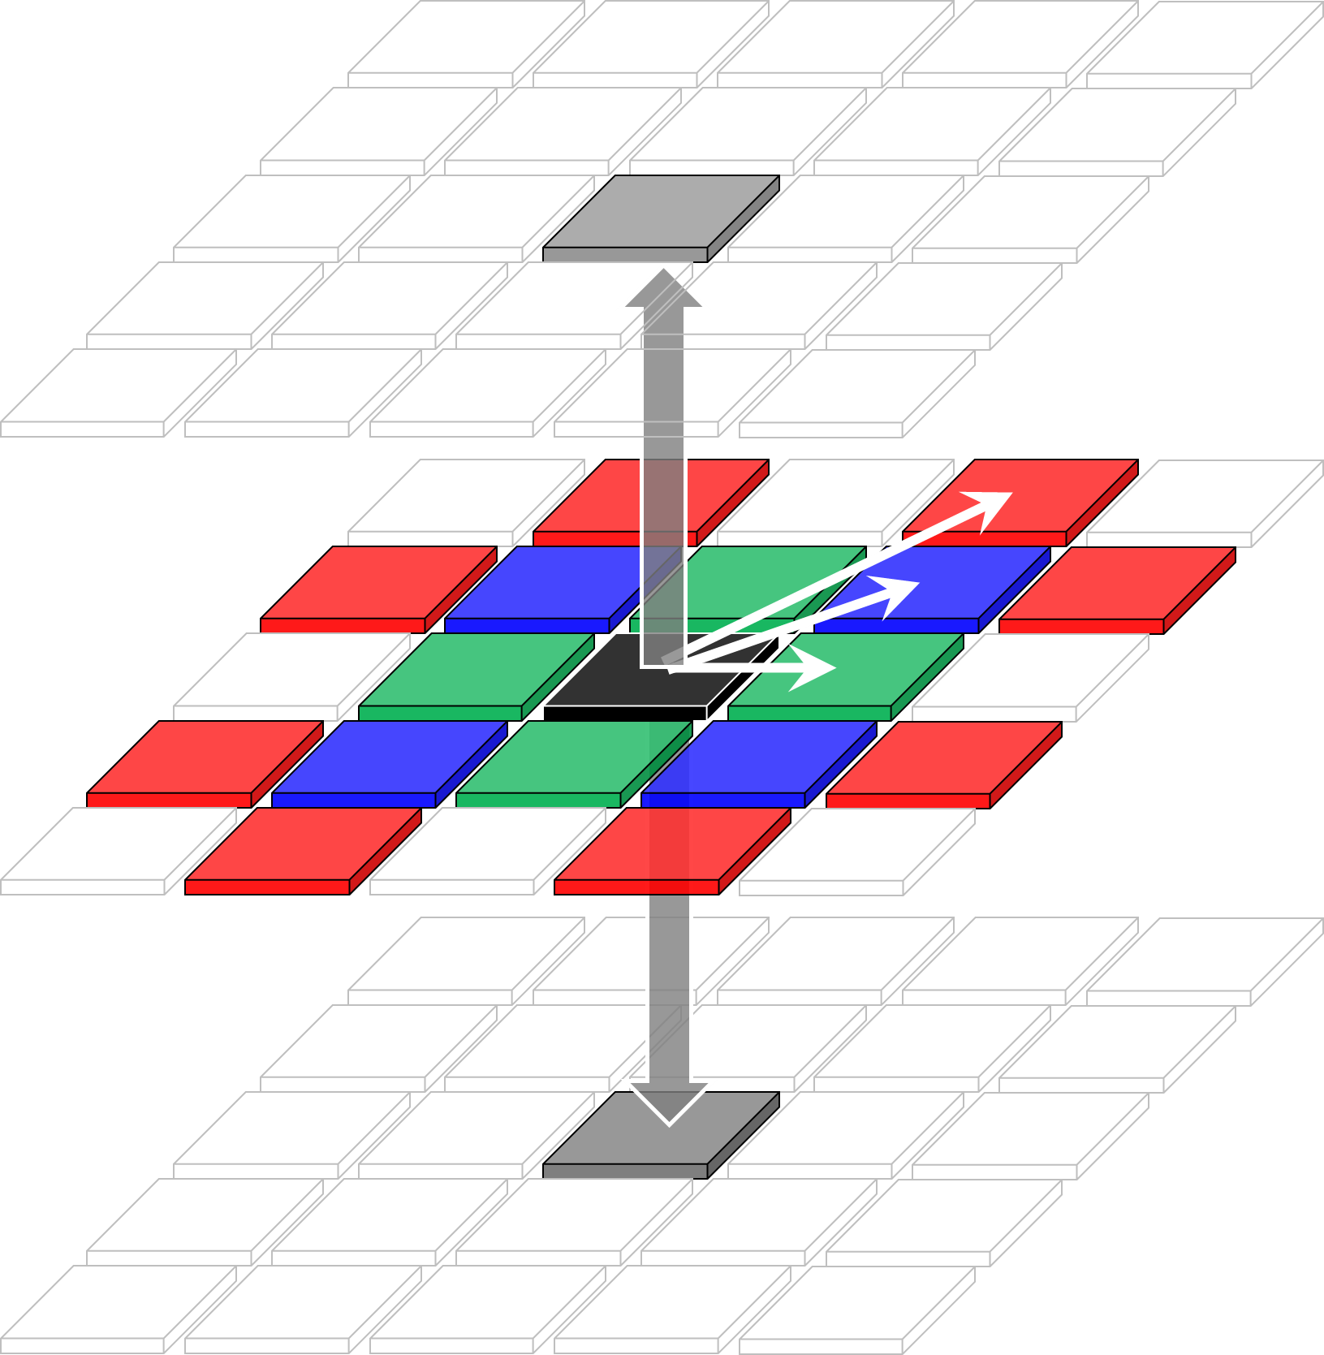

Slide 33
Congestion Deposition

Slide 35

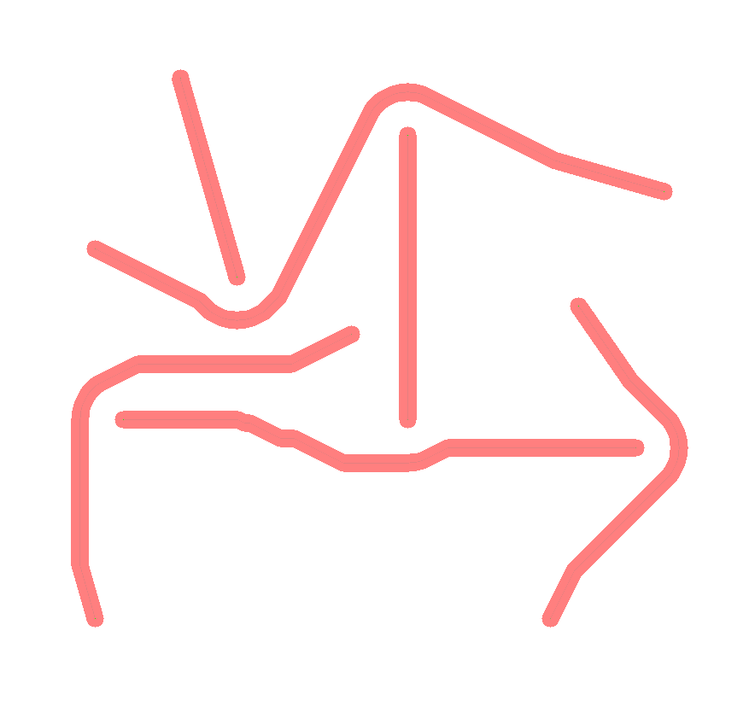
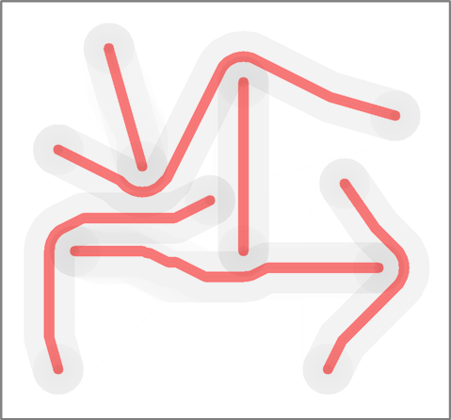

Slide 37










Slide 38
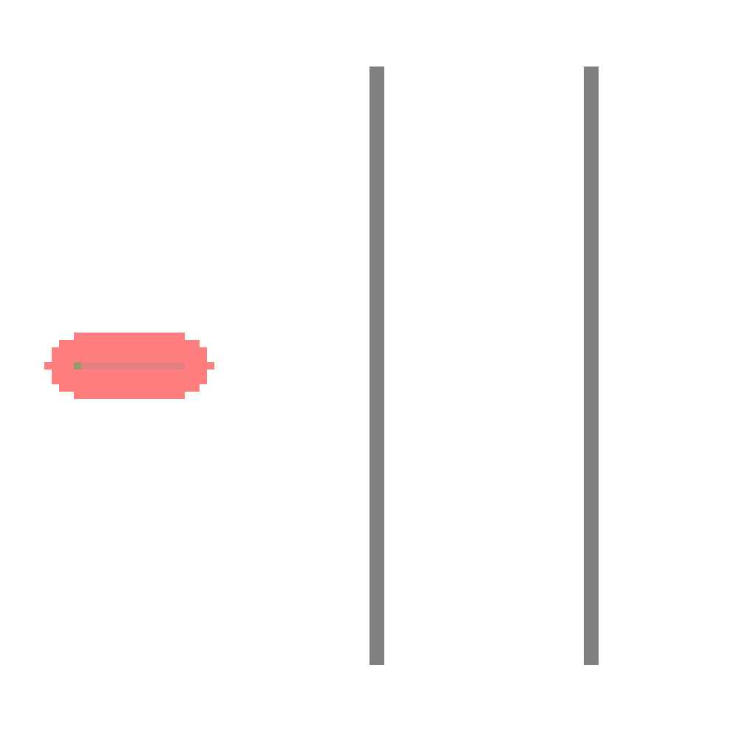
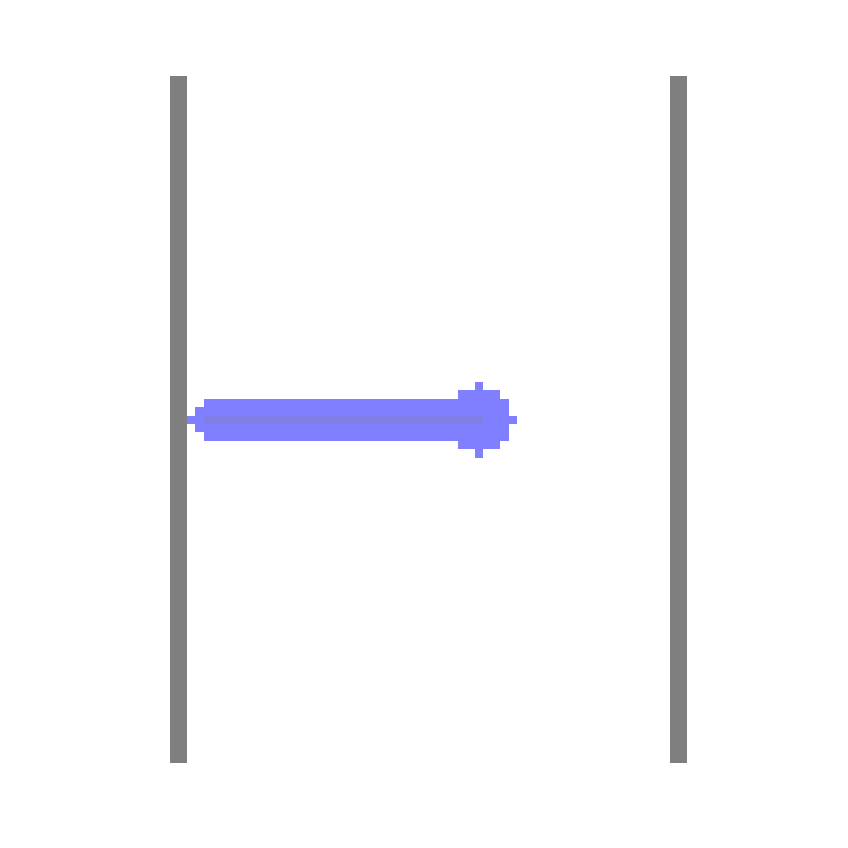
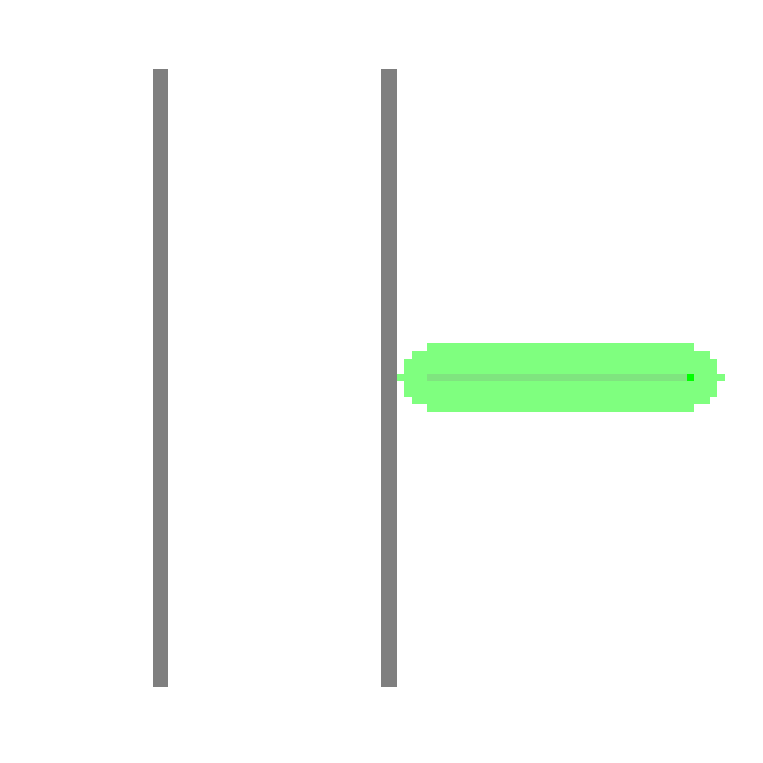
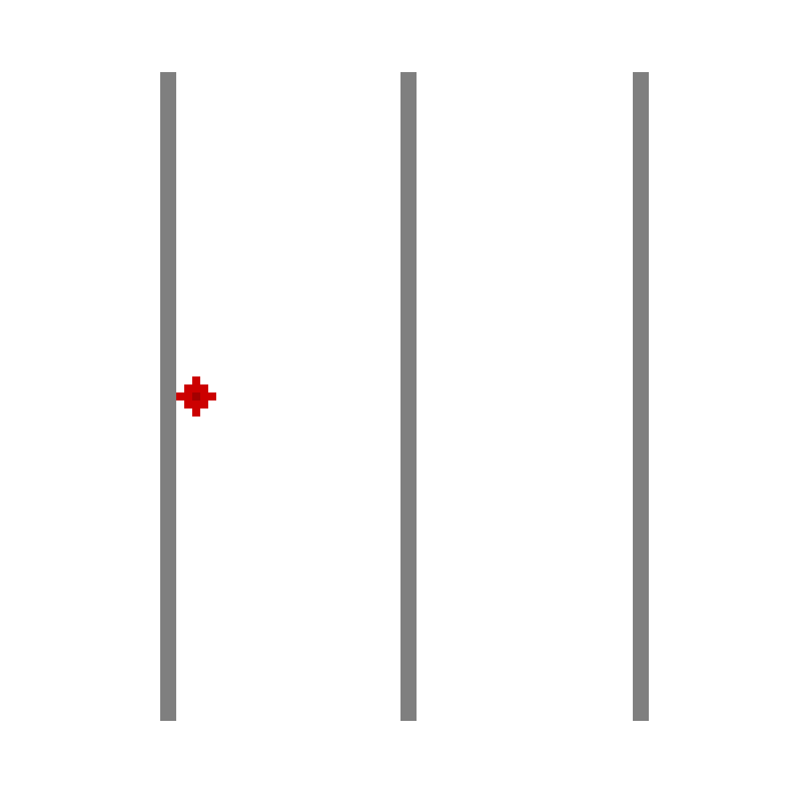
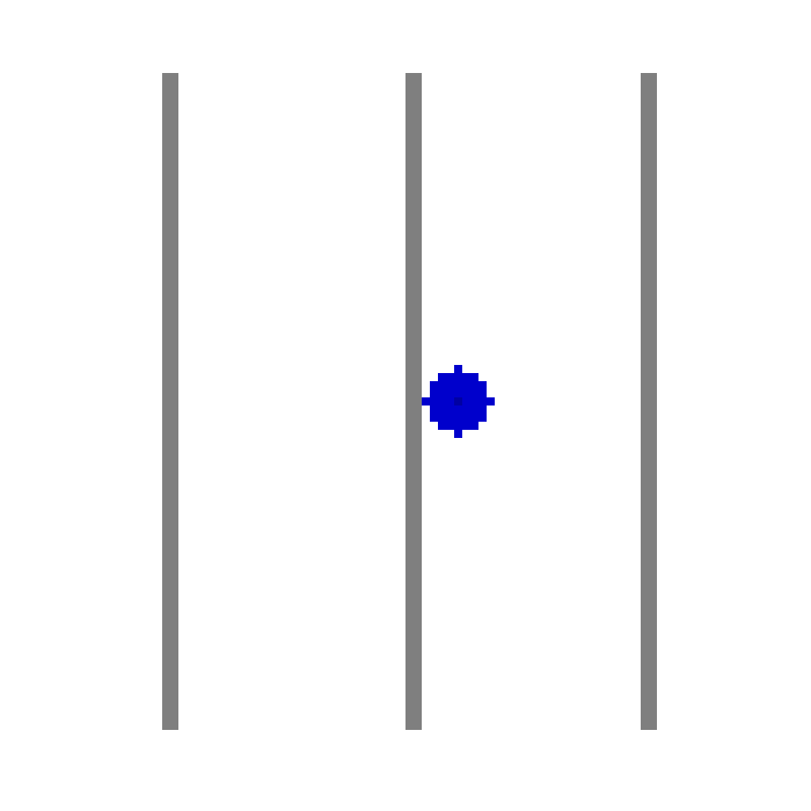

Slide 40
Iterative Routing (when to stop?)

Slide 42
Post-processing Differential Pairs
Pseudo-path to shoulder-paths
Creating vias
Deciding which via connects to which path
Filling in the gaps

Slide 47
DP vias

Slide 51
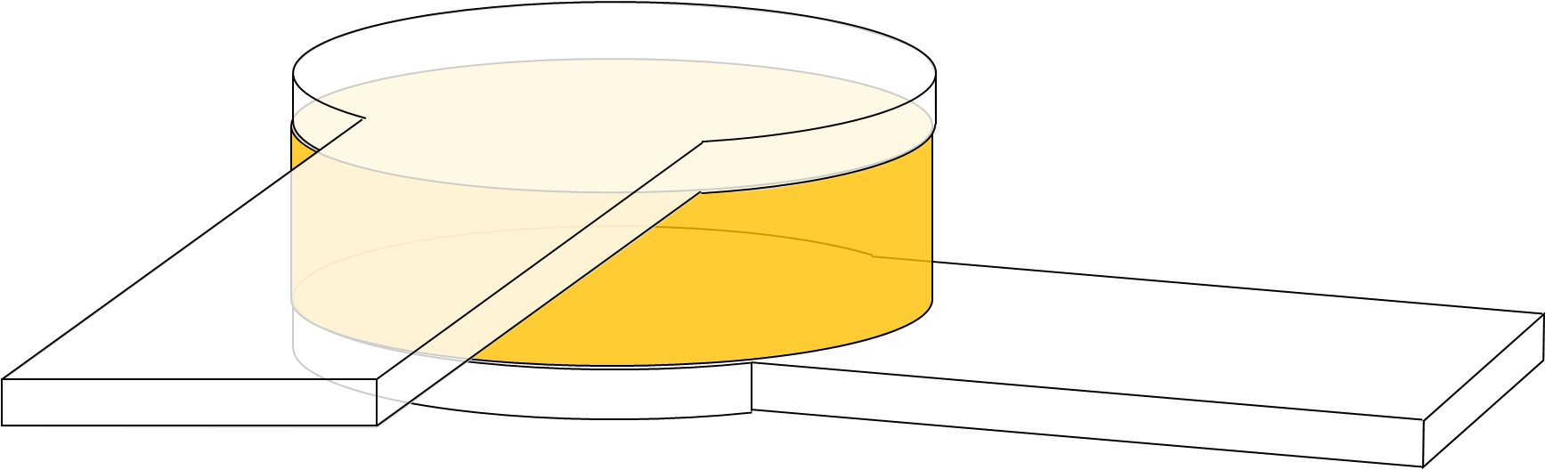
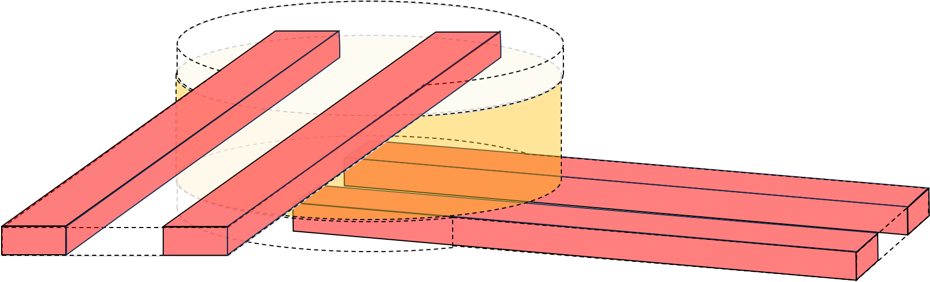
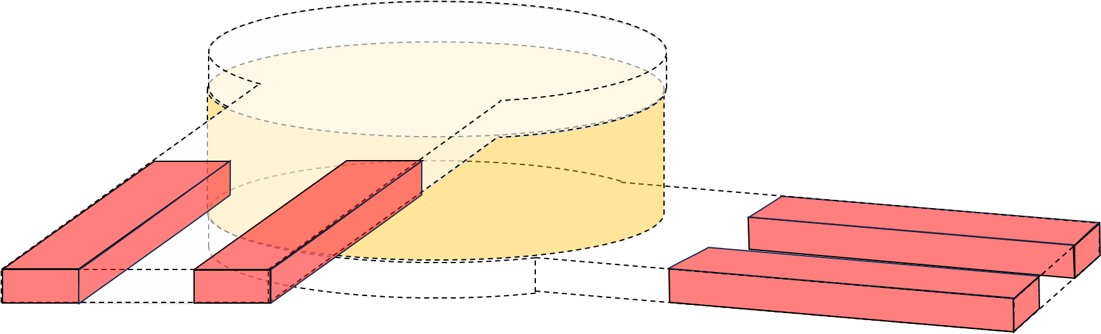
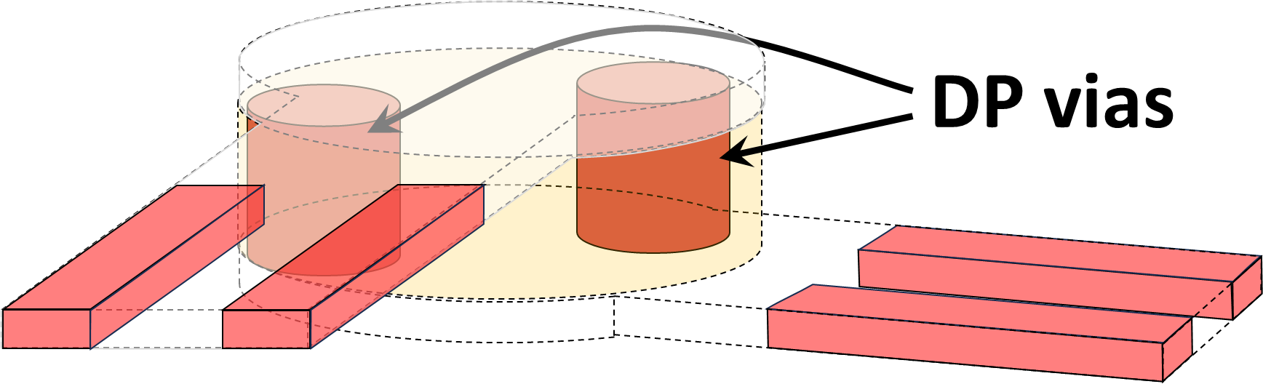
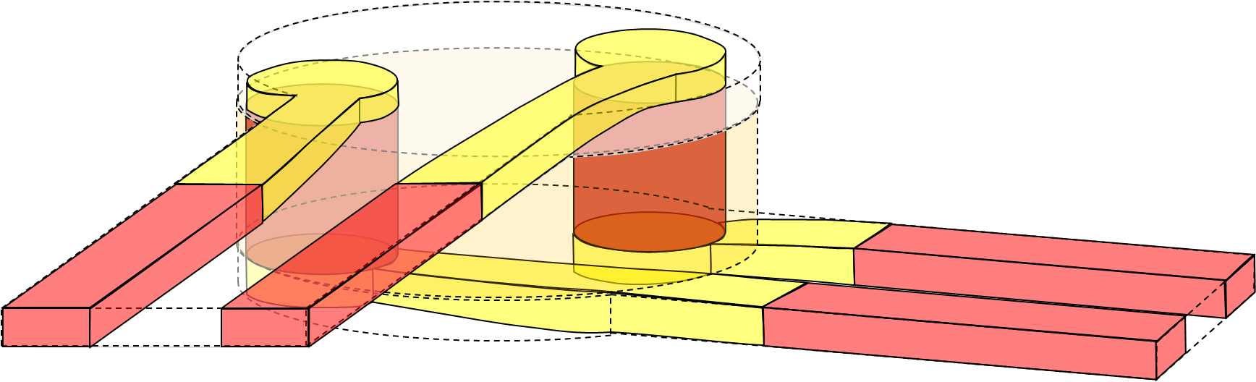
Pseudo
traces
a.
Pseudo
via
Parallel
DP traces
b.
Pruned
DP traces
c.
d.
A*-routed
connections
e.

Slide 52
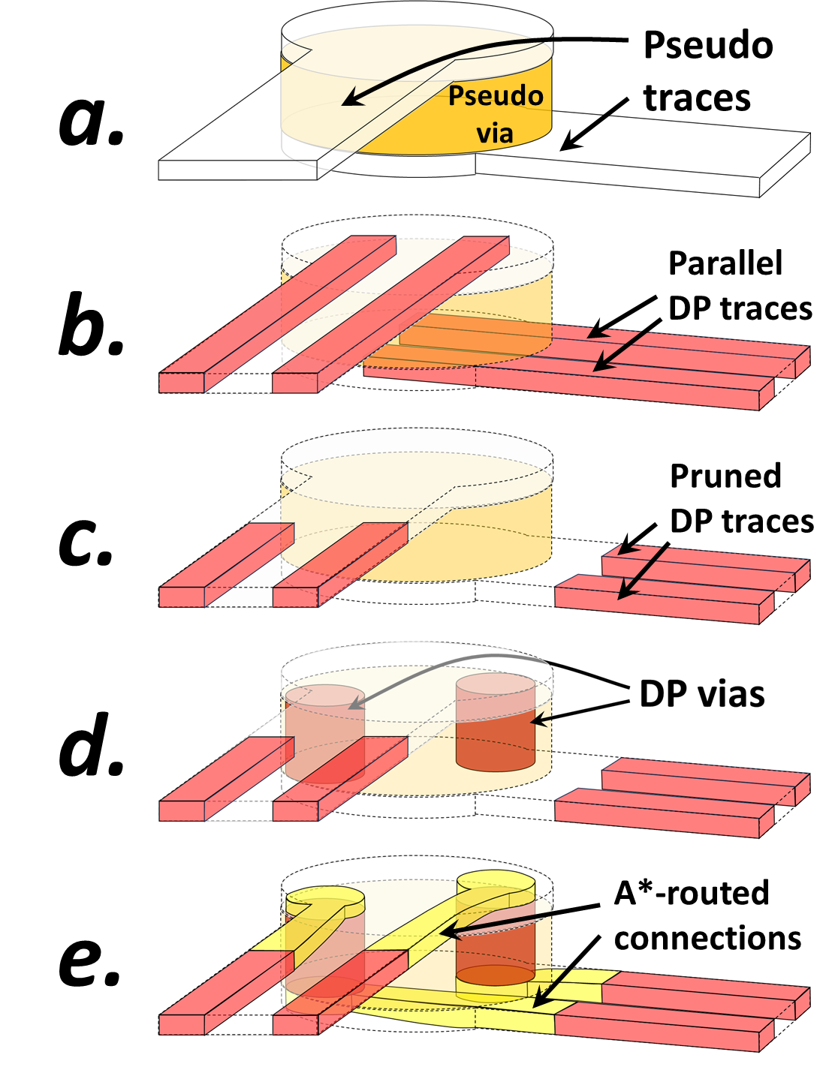

Slide 53
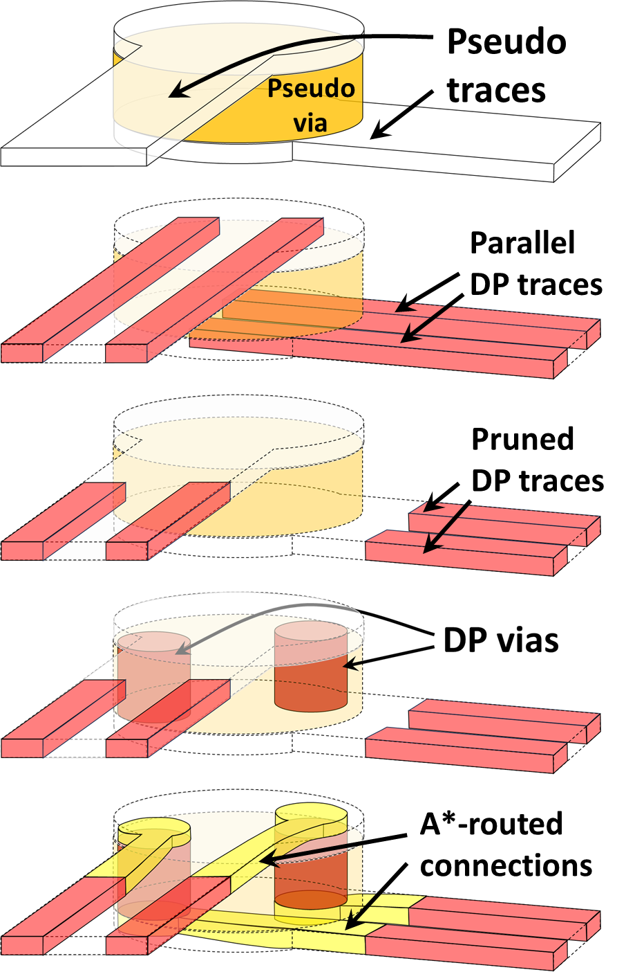
Pseudo
traces
Pseudo
via
Parallel
DP traces
Pruned
DP traces
A*-routed
connections

Slide 54
Real-time Algorithm Tuning

Slide 55
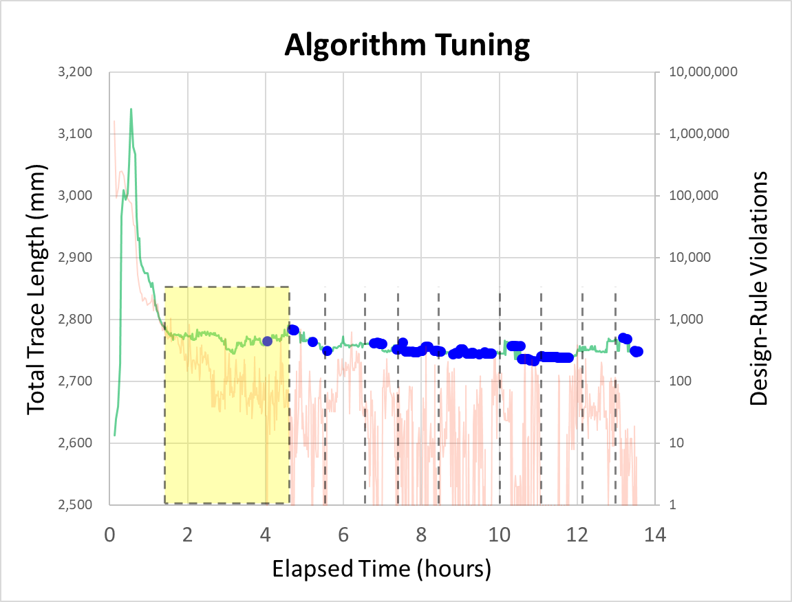
Swap start- and
end-terminals
Adjust sensitivity to congestion
Gradually increasing congestion sensitivity.
Iterations with no design-rule violations

Slide 56
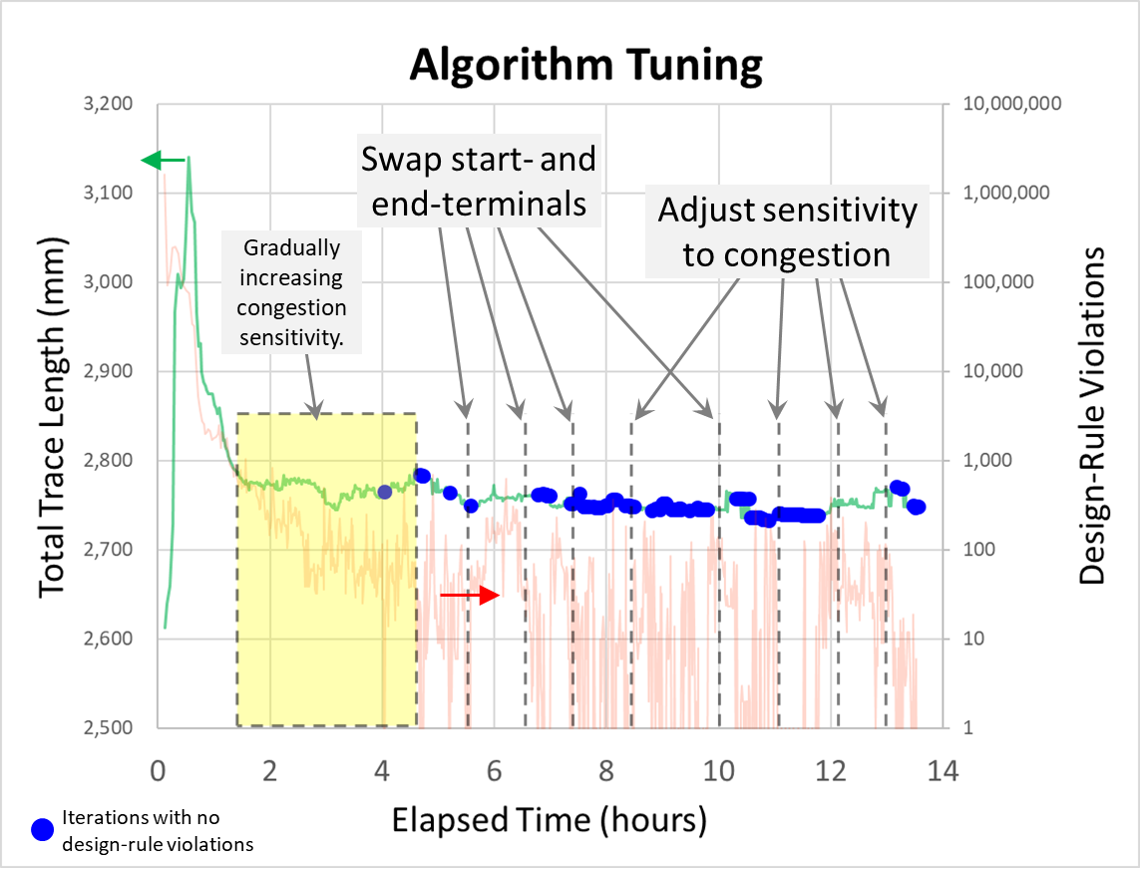

Slide 57
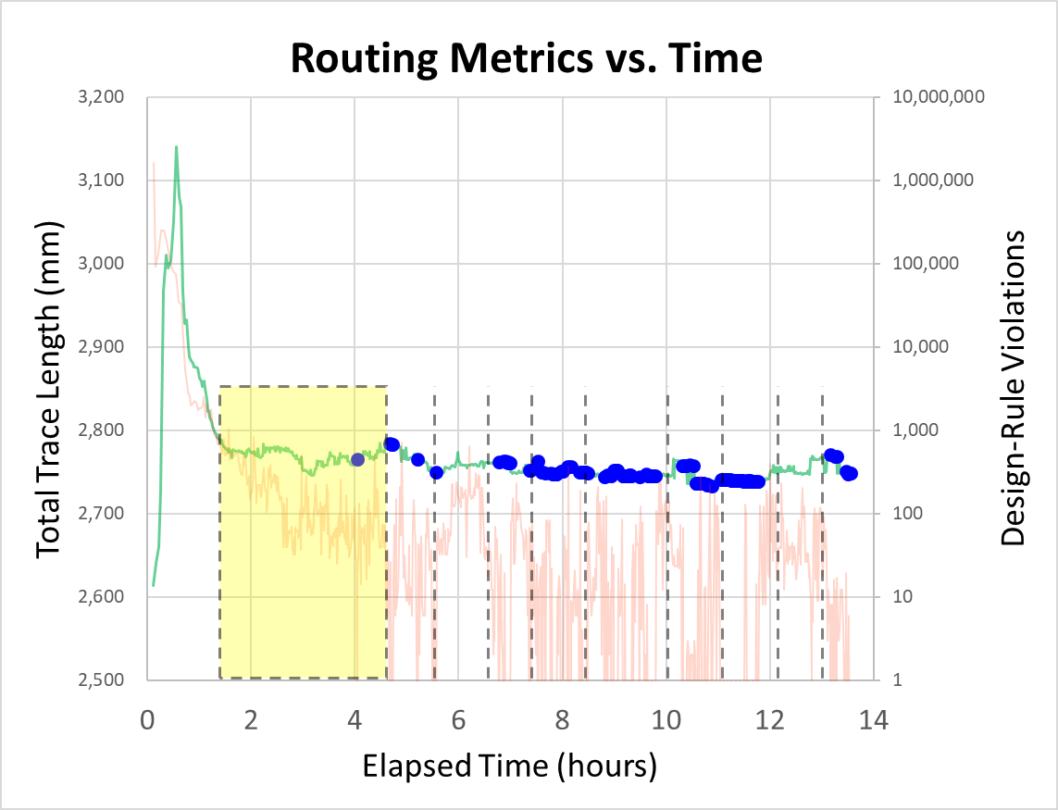
Swap start- and
end-terminals
Adjust sensitivity to congestion
Gradually increasing congestion sensitivity.
Iterations with no design-rule violations

Slide 58
DRC-free
solutions
DRC-free
solutions
After increasing
congestion
sensitivity
G-cost
G-cost
G-cost local minima
with design-rule violations
G-cost minima with design-rule violations
Routing Configurations
Routing Configurations

Slide 59
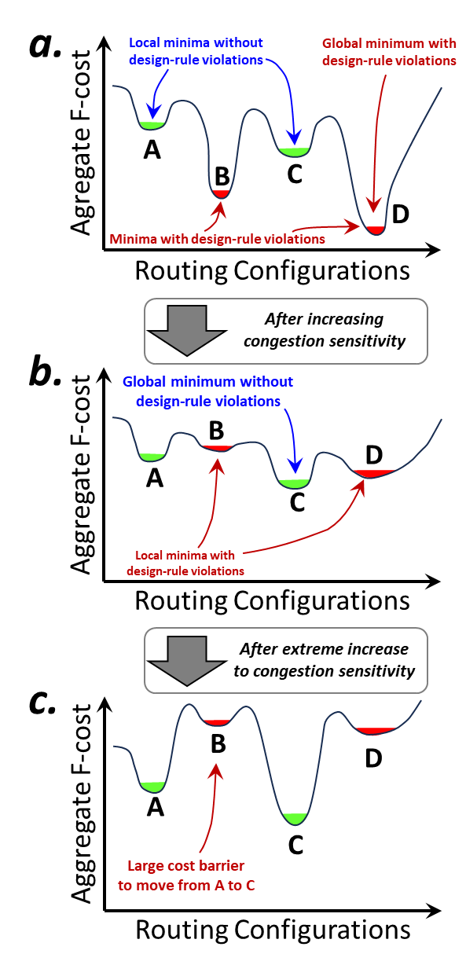
a.
Local minima without
design-rule violations
Global minimum with
design-rule violations
Agregate F-cost
A
B
C
D
Minima with design-rule violations
Routing Configurations
After increasing
congestion sensitivity
b.
Global minimum without
design-rule violations
B
D
Aggregate F-cost
A
C
Local minima with
design-rule violations
Routing Configurations
After extreme increase
to congestion sensitivity
c.
B
D
Aggregate F-cost
A
C
Large cost barrier
to move from A to C
Routing Configurations

Slide 60
After increasing
congestion sensitivity
After extreme increase
to congestion sensitivity
a.
b.
Local minima without
design-rule violations
Global minimum with
design-rule violations
Global minimum without
design-rule violations
B
D
Agregate F-cost
Aggregate F-cost
A
A
B
C
C
D
Minima with design-rule violations
Local minima with
design-rule violations
Routing Configurations
Routing Configurations
Figure 11: Conceptual representation of the total routing cost as a function of routing configurations (a). Increasing the congestion sensitivity (b) increases the cost of unwanted minima without affecting violation-free minima. Extreme increases to the sensitivity (c) cause large barriers between violation-free minima
c.
B
D
Aggregate F-cost
A
C
Large cost barrier
to move from A to C
Routing Configurations

Slide 62
Results: Package Routing

Slide 63
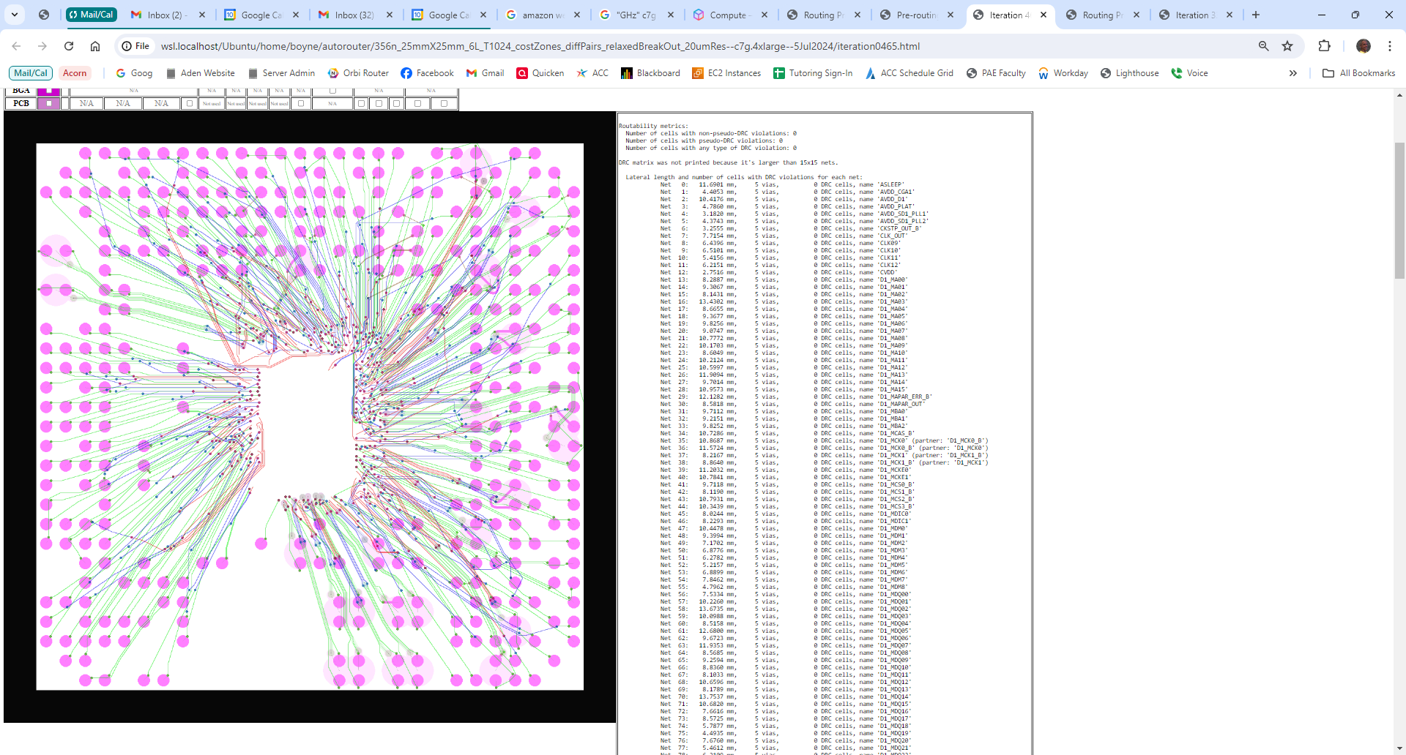
file://wsl.localhost/Ubuntu/home/boyne/autorouter/356n_25mmX25mm_6L_T1024_costZones_diffPairs_relaxedBreakOut_20umRes--c7g.4xlarge--5Jul2024/iteration0465.html

Slide 64
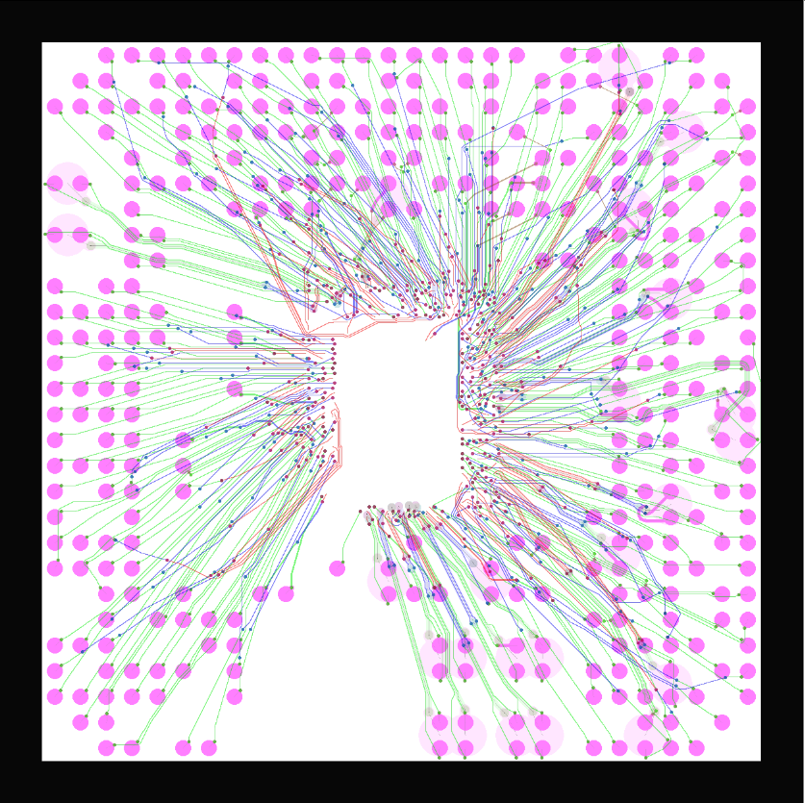

Slide 65
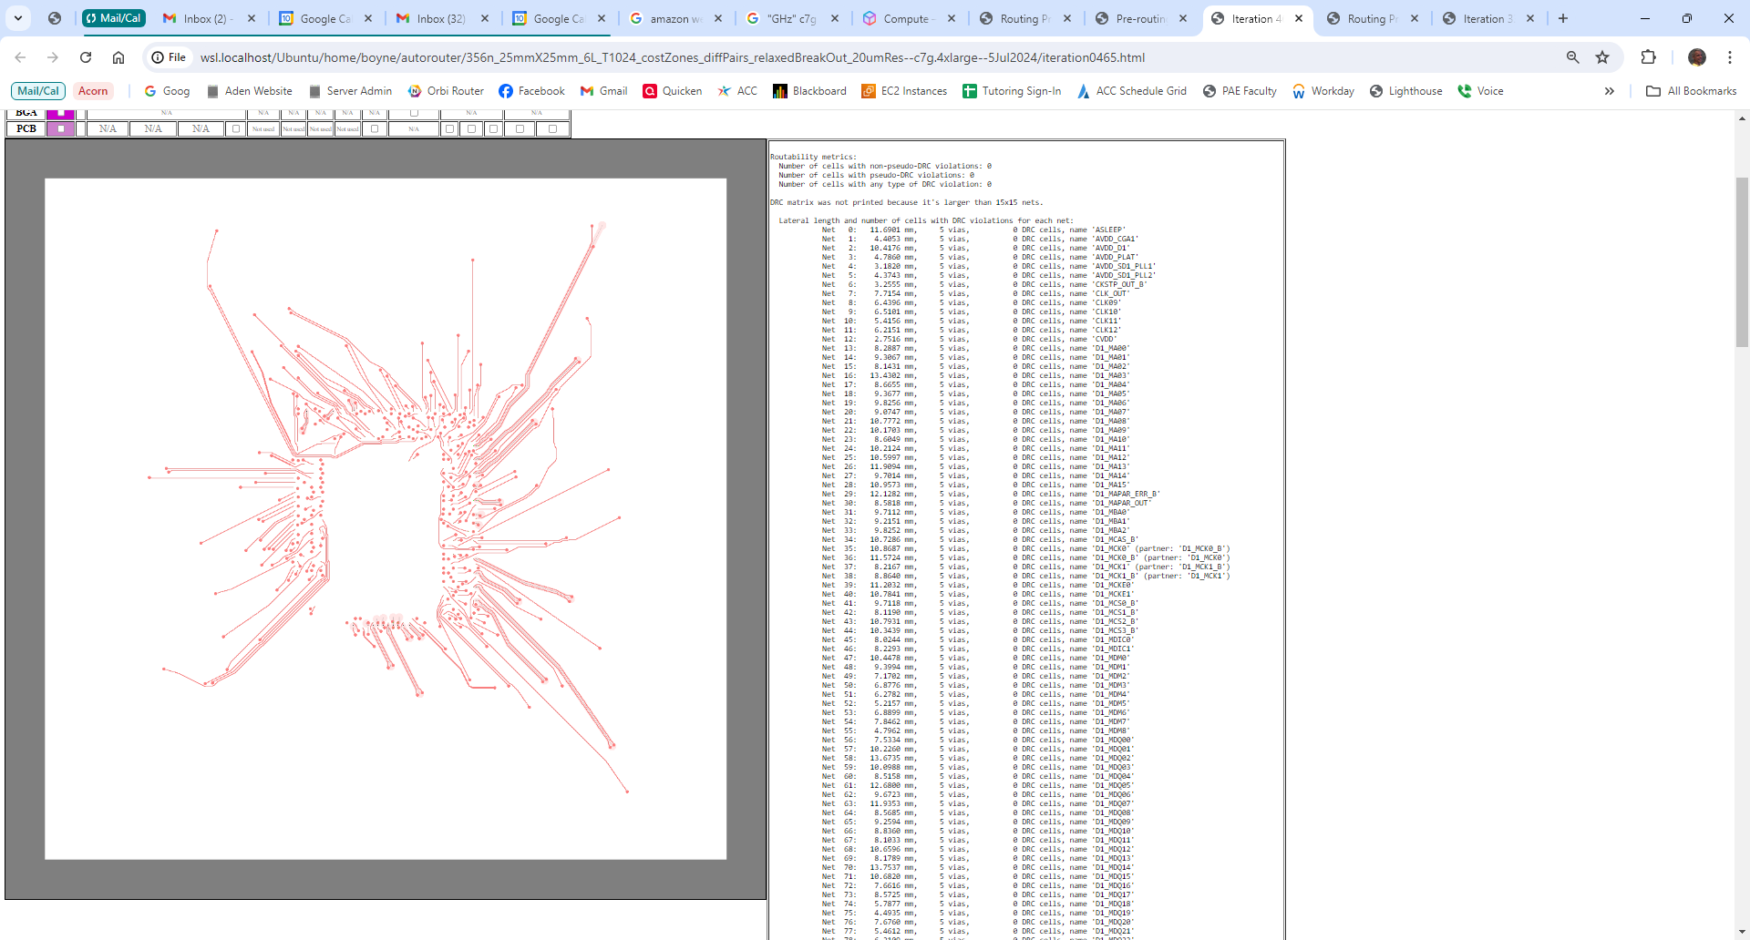
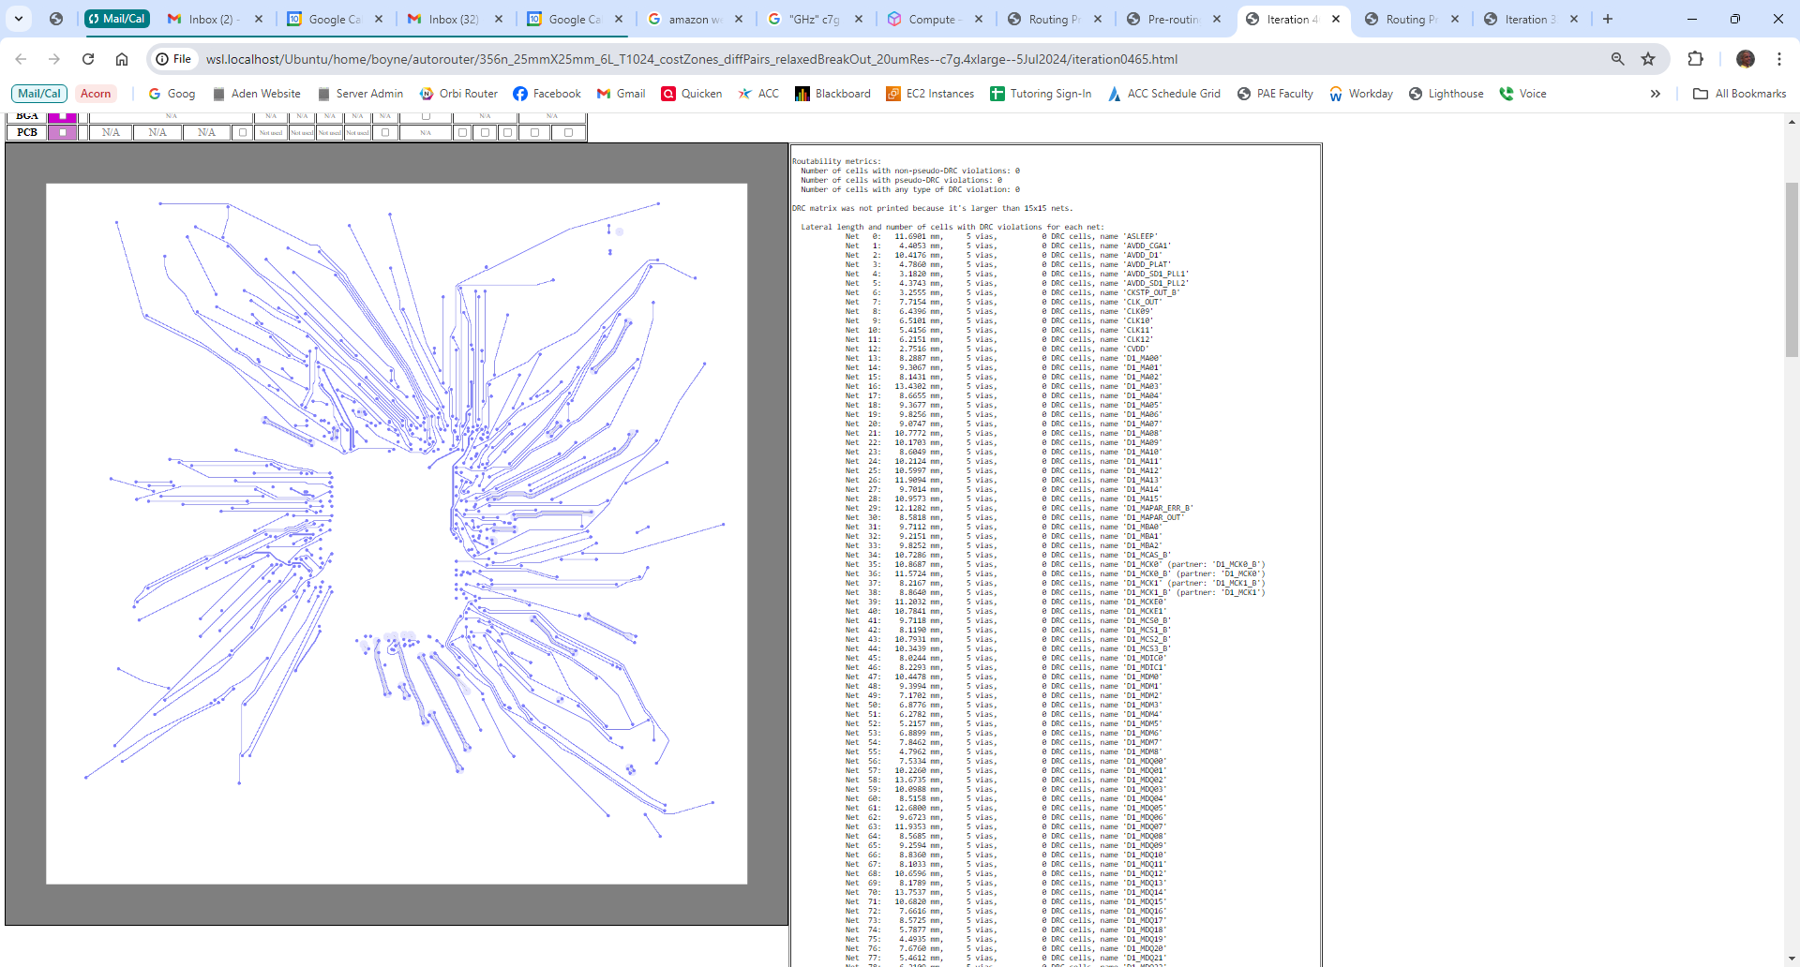
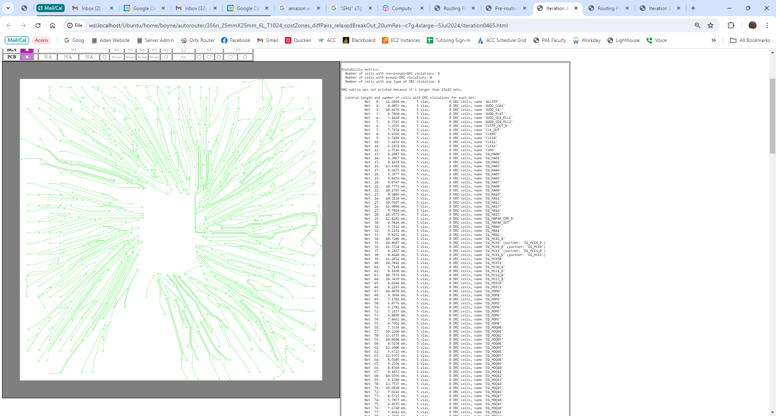
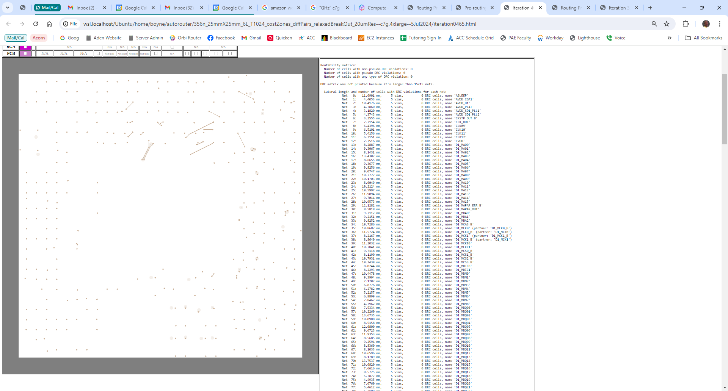
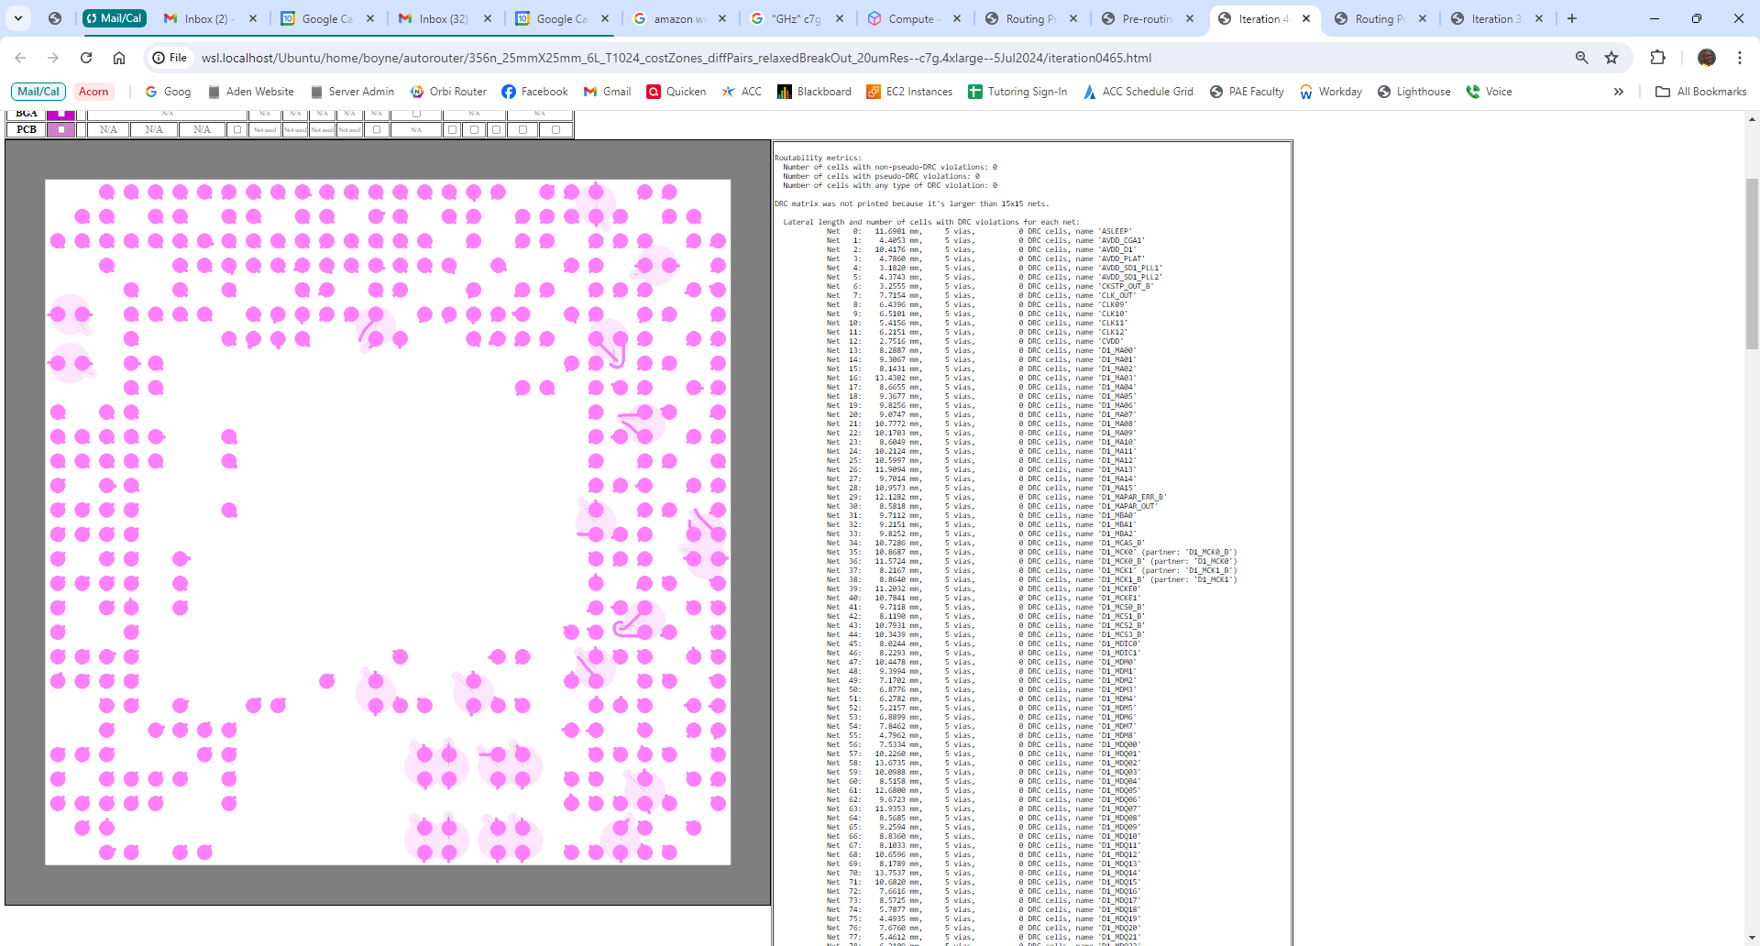

Slide 66
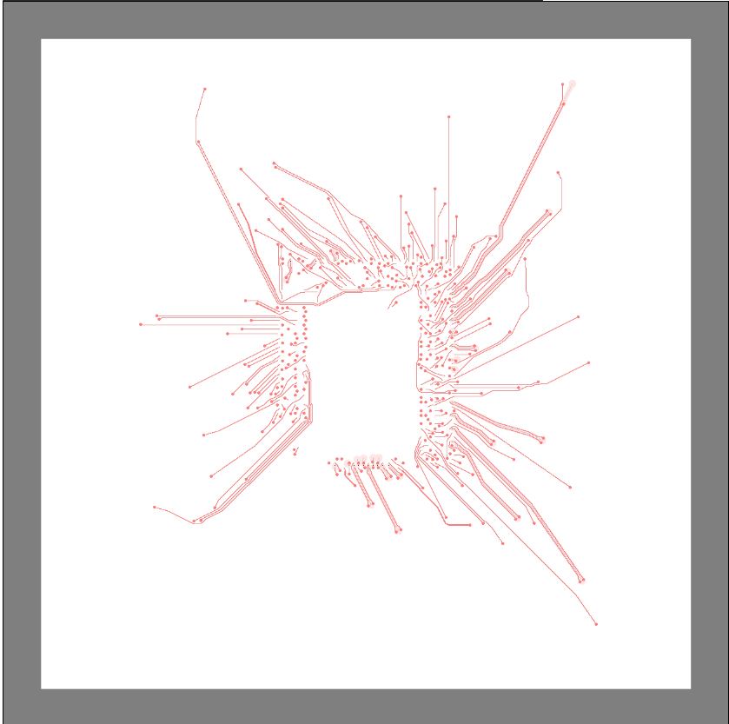
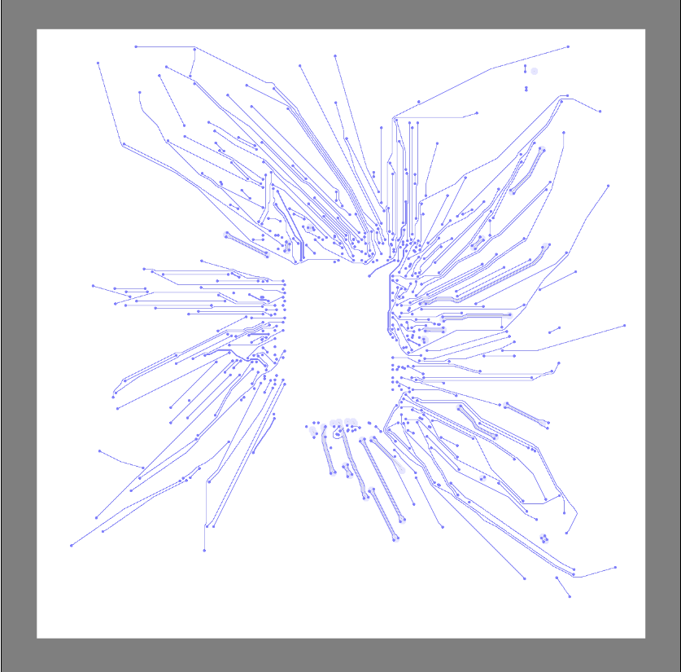
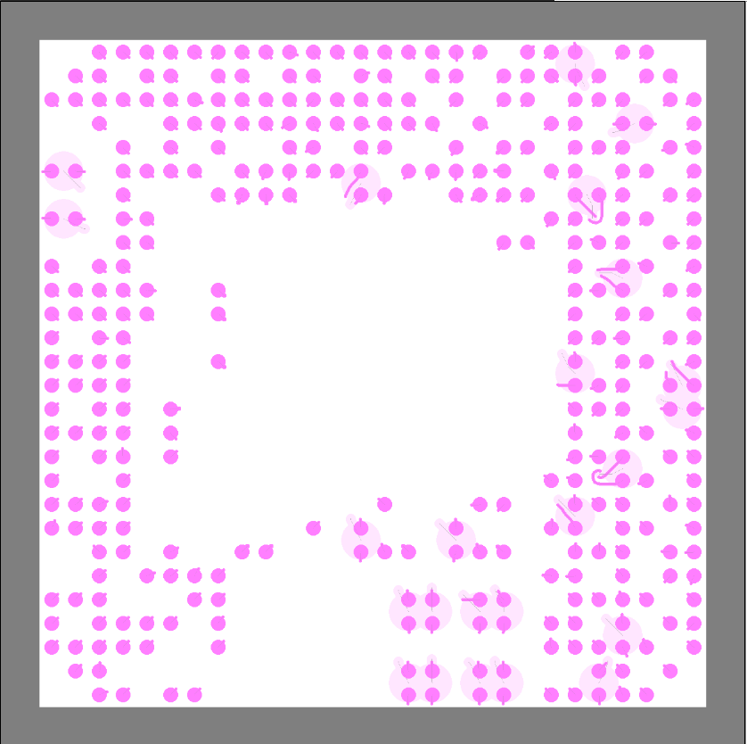

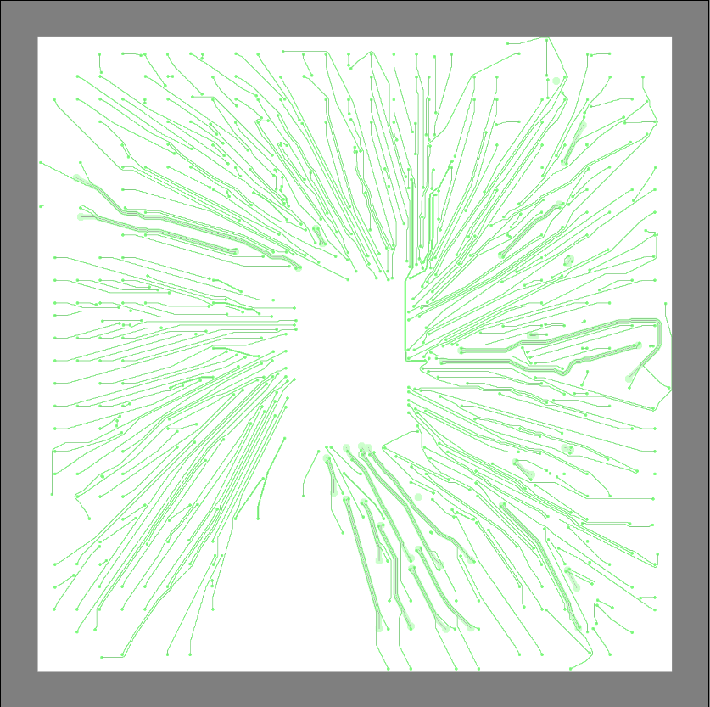
Approximate
die outline
b. Layer 1
a. All layers
c. Layer 2
f. Layer 5
e. Layer 4
d. Layer 3

Slide 67
Approximate
die outline
Package Layer 1
All package layers
Package Layer 2
Package Layer 5
Package Layer 4
Package Layer 3

Slide 68
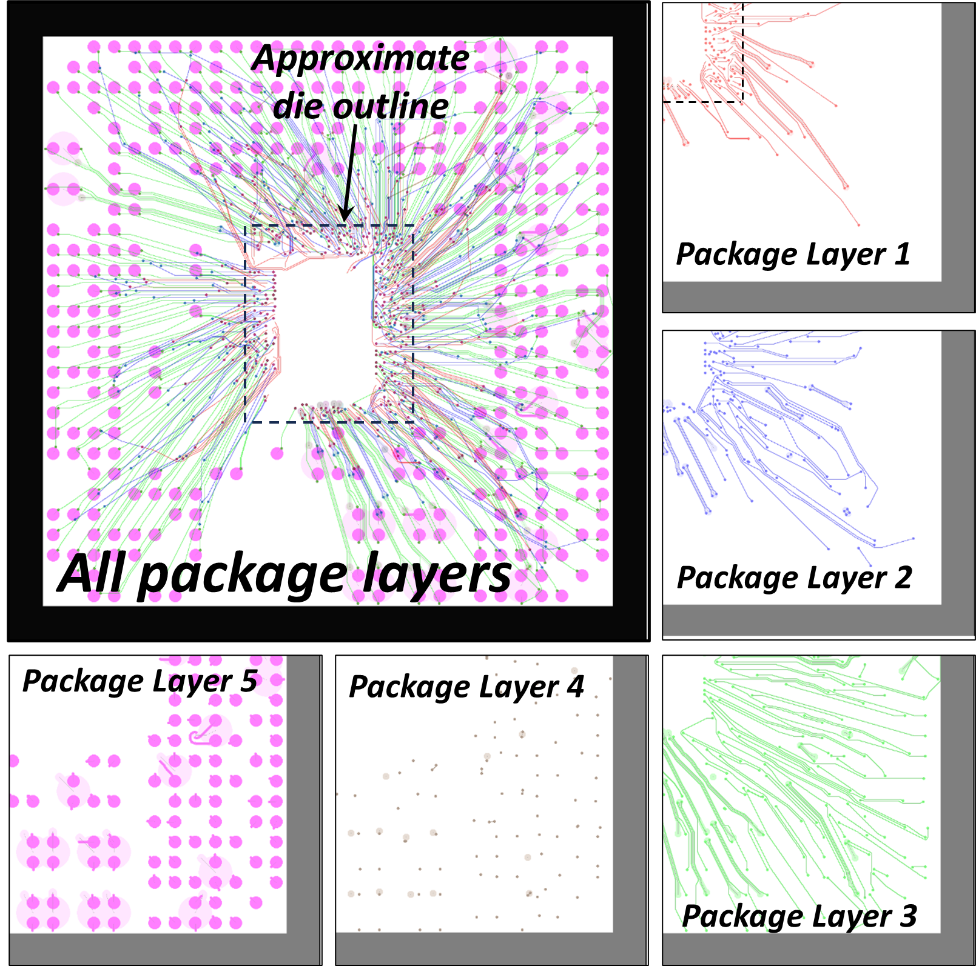

Slide 69
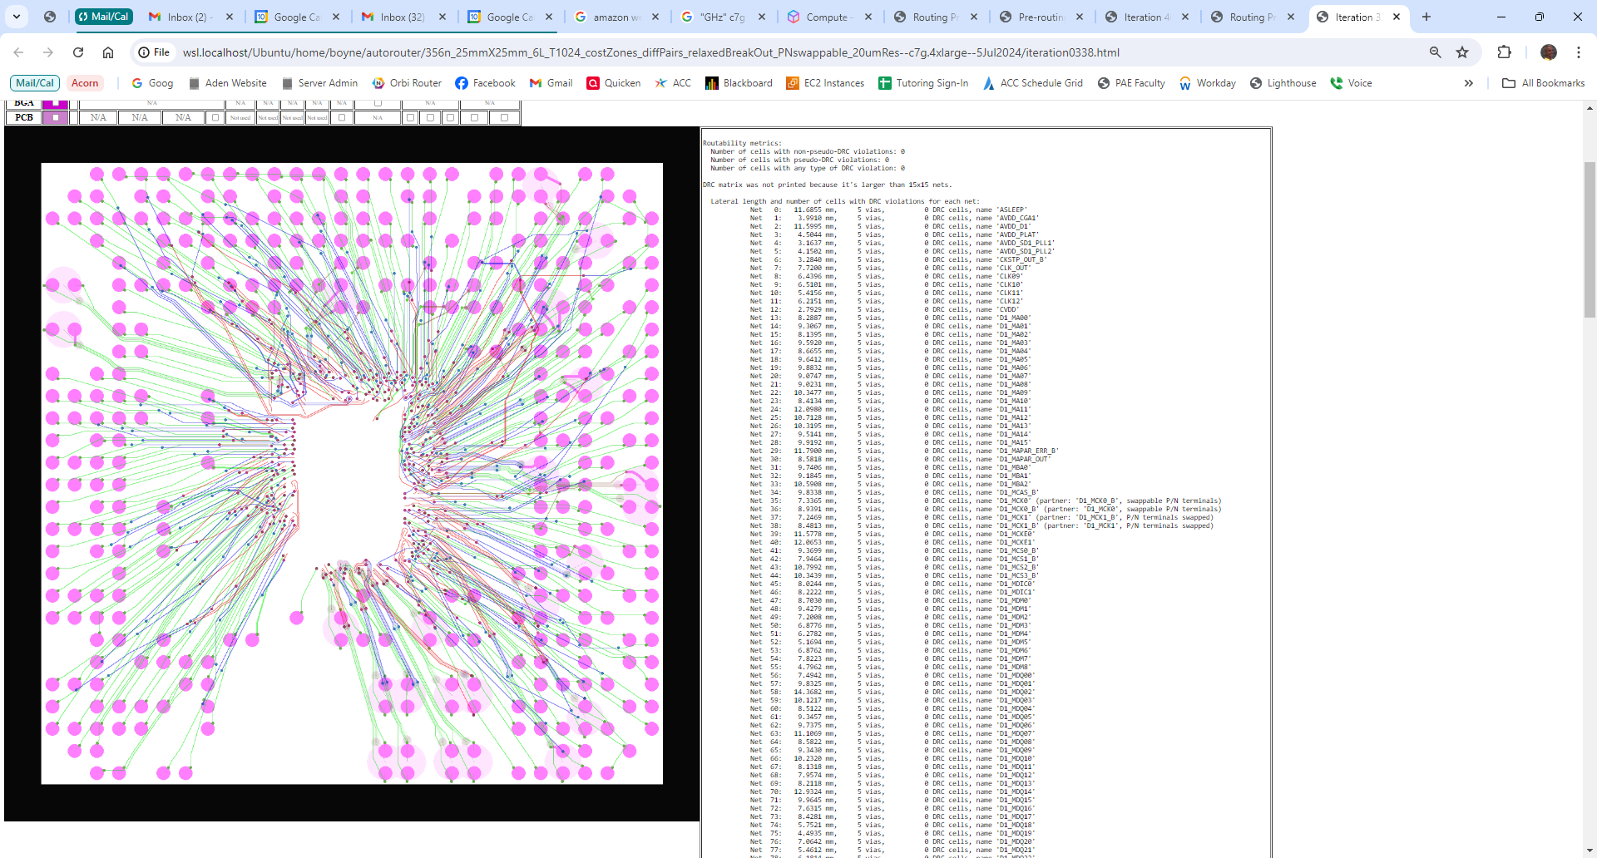
file://wsl.localhost/Ubuntu/home/boyne/autorouter/356n_25mmX25mm_6L_T1024_costZones_diffPairs_relaxedBreakOut_PNswappable_20umRes--c7g.4xlarge--5Jul2024/iteration0338.html

Slide 70
Results: Package & PCB Routing

Slide 71
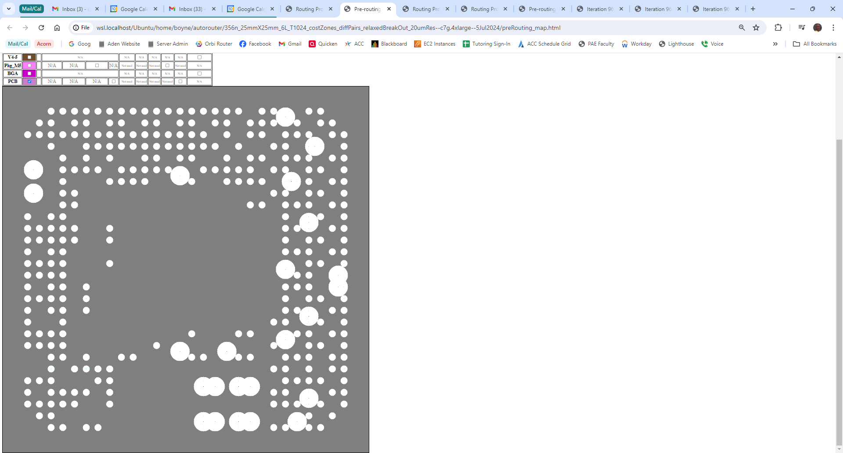
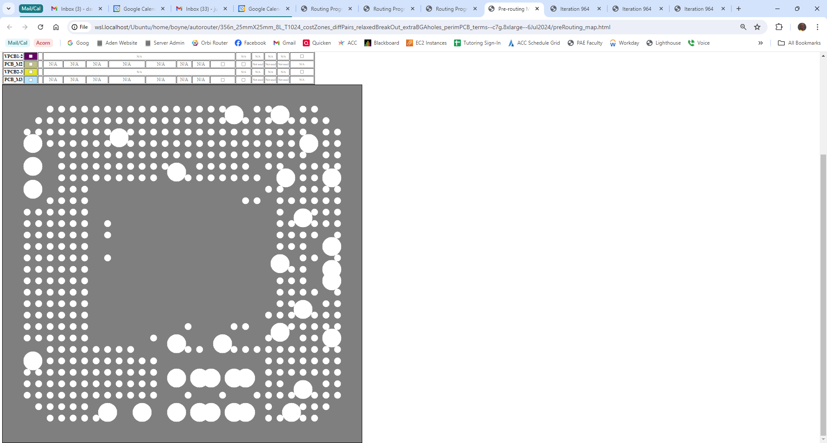
Extra
waypoints
added
No extra
waypoints
a.
b.

Slide 72
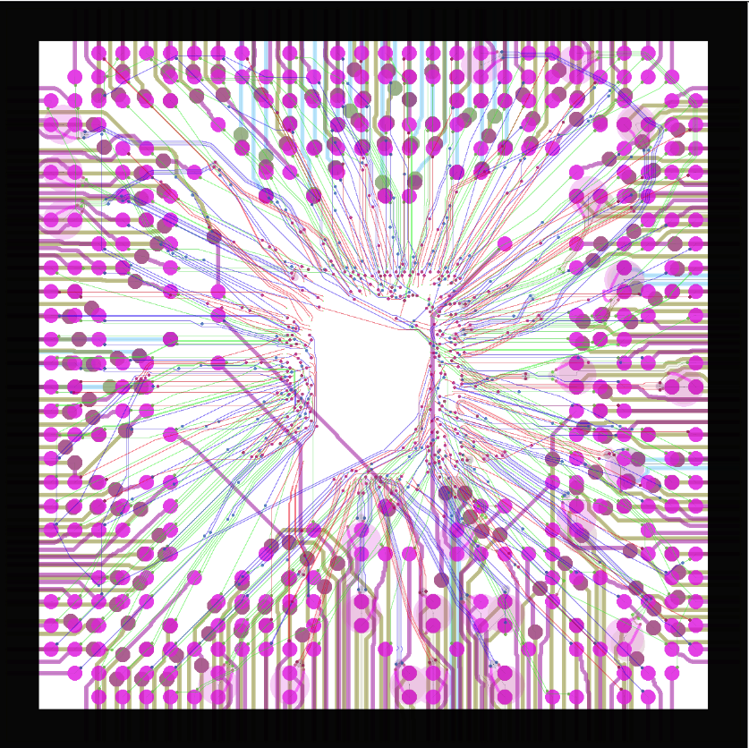
file://wsl.localhost/Ubuntu/home/boyne/autorouter/356n_25mmX25mm_8L_T1024_costZones_diffPairs_relaxedBreakOut_extraBGAholes_perimPCB_terms--c7g.8xlarge--6Jul2024/iteration0964.html

Slide 73
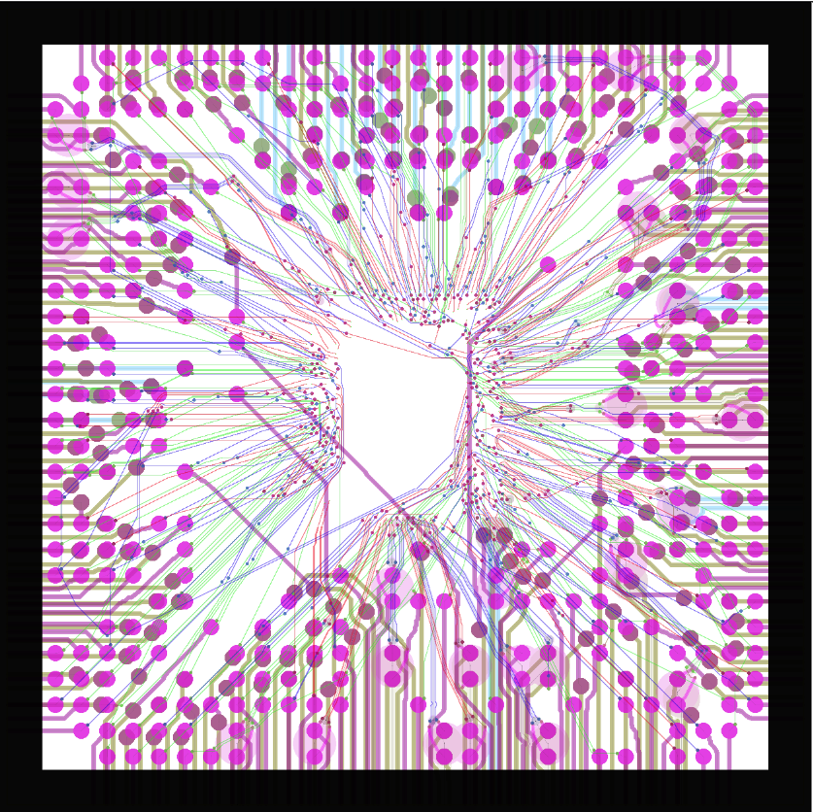
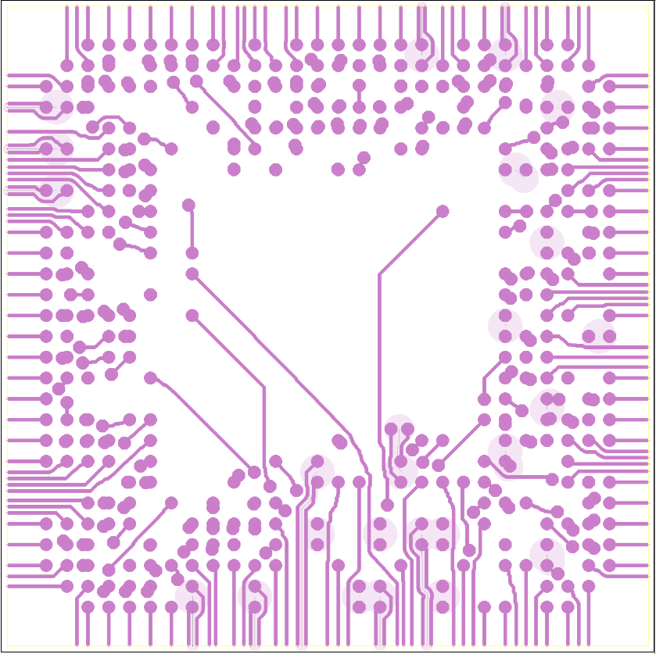


a. All layers
b. PCB layer 1
d. PCB layer 3
c. PCB layer 2

Slide 74
Package & PCB Layers
PCB layer 1
PCB layer 3
PCB layer 2

Slide 75


Slide 76


Slide 77


Slide 78


Slide 79


Slide 80
Results: Die, Package and PCB Routing

Slide 81

file://wsl.localhost/Ubuntu/home/boyne/autorouter/356n_25mmX25mm_10L_T1024_costZones_diffPairs_dieTerms_extraC4andBGAholes_perimPCB_terms--c7g.16xlarge--8Jul2024/iteration0919.html

Slide 83


Slide 84


Slide 85



Slide 86



Slide 87


Slide 90
Die terminals (green)
Die
area
Die
routing
Package and
PCB area
Unused C4 sites
(white)
C4 connections
(blue)
RDL (red)

Slide 91


